Slide 1

Advanced Transportation & Energy
Presentation to the Standing Senate Committee on
Energy, the Environment and Natural Resources
Winnipeg, MB
2011 12 07
Ray Hoemsen, FEC, P. Eng.
Director, Applied Research & Commercialization
Red River College

Slide 2
Scope
Colleges and Applied Research
Capabilities
Case Histories
Answering Your Questions
Industry-Specific Recommendations
. . . . . from a College Point-of-View

Slide 3

Red River College
Second largest post-secondary institution in Manitoba
Over 140 full-time government-supported academic programs
Manitoba’s largest school of continuing and distance education
32,000 student enrolments
Nine campuses across Southern Manitoba
Annual operating budget ~$150M
Applied research volume ~$1M (not including capital)
  50⁺ public- and private-sector partners since 2004

Slide 4
College-based (Applied) Research is…..
Application of Knowledge
  Problem solving
    Focus on the “HOW” not the “WHY”
  Technology diffusion (vs. commercialization)
    Adoption and adaption of technology
  Knowledge translation
    Putting the research results (often from others) into practise

Slide 5
College-based (Applied) Research Features
Applied, not discovery, research
Group, not individual, basis
Focus on work of students vs. instructors
Shorter term, problem solving focus
More community/regional connection/relevance
No graduate students, students hired on project basis
Greater flexibility, shorter timelines (w.r.t. agreements)
Intellectual Property – few/no patents
  Commercial rights routinely assigned to sponsor
  Research and education rights retained

Slide 6
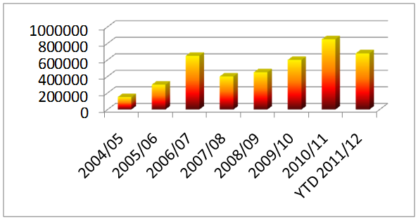

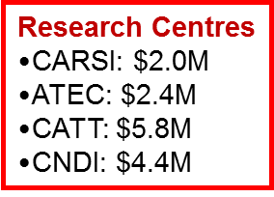
Applied Research @ Red River College
2011/12: does not include E-bus (MHI/MB/MH/NFI – E-Bus - $3M)
Manitoba Roundtable on Sustainability Award of Excellence 2009
Winnipeg Chamber of Commerce Spirit of Winnipeg Award 2010
ACCC National Gold Leadership Award 2011

Slide 7
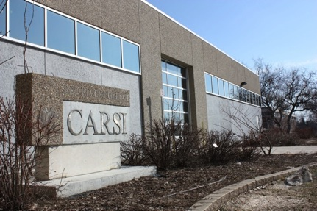
Capabilities: CARSI
Centre for Applied Research in Sustainable Infrastructure
Environmental chambers (side-by-side)
  -40º C to + 40º C, independently controlled, additive humidity
  Common wall to enable “inside and outside” test conditions
  Able to accommodate a small electric vehicle (e.g. iMiev)
Flexible, multi-channel data acquisition system
Structural dynamic test system with “strong” floor
Removable exterior wall section for climactic testing
Structural health monitoring
Prototype “skunkworks” development
Cold weather performance
  Building and construction materials, components and systems

Slide 8
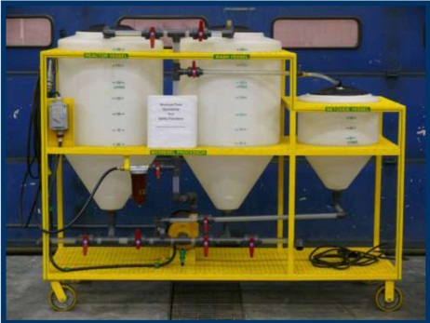
Capabilities: ATEC
Advanced Transportation & Energy Centre
3,000 sq. ft. dedicated applied research space
  integrated within the Heavy Equipment Transportation Centre
  Portable vehicle emissions testing (NOx, SOx, particulate matter)
  1,000 HP chassis and 1,000 HP engine dynamometers (to-be-installed)
  Bio-diesel refinery (small scale)
Improving fuel efficiency, especially w/ renewable fuels
  Bio-diesel, electricity, ethanol, hydrogen
Cold weather applications
    Product development – prototyping and testing
    Field demonstrations and evaluations
Electric Vehicle Technology & Education Centre (virtual)

Slide 9
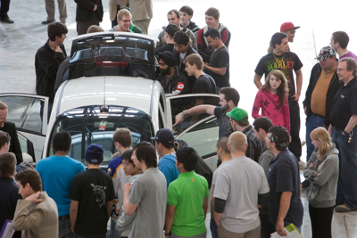
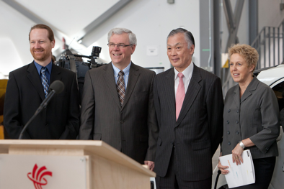
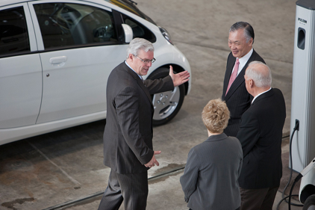
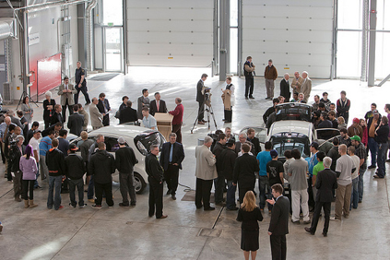
Capabilities: EVTEC
Electric Vehicle Technology and Education Centre
Demonstration and public education site for all-electric and plug-in hybrid-electric vehicles and recharging equipment
Provincial support based on RRC’s track record of applied research and demonstration projects in advanced transportation
Mission:
  Support electric vehicle innovation in/by Manitoba’s transportation sector
  Enhance electric vehicle education at RRC and in the region
  Increase public awareness of electric vehicle technology

Slide 10









Case: Advanced Transportation & Energy
Fuel efficiency, renewable fuels, and cold weather operation for vehicle technology
Research infrastructure capital support ($2.3M)
  Fuel system icing simulator (GLACIER support)
E-bus: battery, not trolley ($3M)
Electric Vehicle Technology & Education Centre
Participation in numerous public advisory bodies
Notes:
NFPA training.

Slide 11




All Electric Transit Bus (e-bus) Project
Public-Private Partnership
  MHI, New Flyer Industries, Manitoba Hydro, Province of Manitoba, RRC
  $3-million, three-year project
  Project development at RRC (EVTEC) and NFI Winnipeg
Goals
  Develop a prototype advanced battery electric-bus
    Utilizing MHI and NFI technologies
  Demonstrate the bus and associated charging technologies
  Test operational capabilities under Manitoba’s extreme climatic conditions
  Use demonstration as a showcase for other potential markets within NA

Slide 12
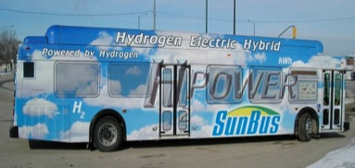
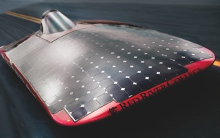
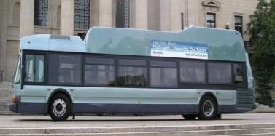
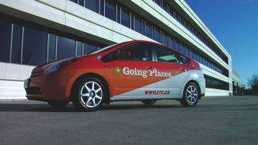
Past ATEC-related Projects
2008-11: Plug-In Hybrid Vehicle cold-weather conversion/modifications, demonstration and monitoring
2009: Electric Vehicle Opportunities Report with EMC
2007 and 2010: Integrated engine/transmission intercity MCI D4500 and J4500 bus prototypes
2006: Hydrogen Fuel Cell transit bus demonstration
2005 and 2008: Red River Raycer solar car
2005: Hybrid Hydrogen Internal Combustion Engine (HHICE) transit bus cold-weather evaluation

Slide 13

NRC-IRAP NMA:
Sustainable Infrastructure & Transportation
NRC-IRAP Network Member since 2008
Sustainable Infrastructure & Transportation focus
2011/2012
  SI&T Cluster Map
  Technology Advisory Support Service (for SMEs)
  On- and Off-Highway Equipment Technology Workshop
Special events, workshops, training seminars

Slide 14
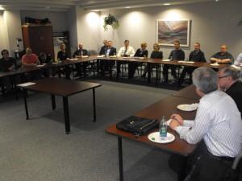
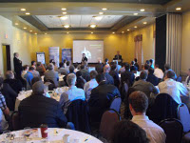
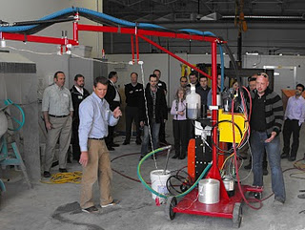
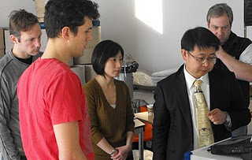
NRC-IRAP NMA: Results and Impacts
Over 600 event, workshop, and training seminar attendees from industry, government, and the College
Increased exposure and awareness of technologies, RRC capabilities and ability to support local industry
Enhanced and more defined industry network
Increased operational skills, experiences, and resources for College faculty and staff to serve SMEs

Slide 15
Improving the Energy Performance of Buildings
NSERC-CCI: $2.3 million to establish and support SITRG
  Commercial and industrial buildings
Applied research to identify or create new or improved approaches for design, construction, renovation and operation
  Reduce energy for space heating, cooling, ventilation, hot water, lighting and plug loads
  Improve building performance monitoring and limit peak electrical demand
  Expand use of renewable energy
  Reduce embodied energy
  Funding for faculty release time, student projects and placements, small equipment, external expertise, and technology transfer

Slide 16
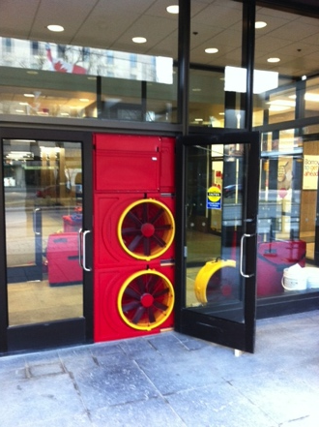
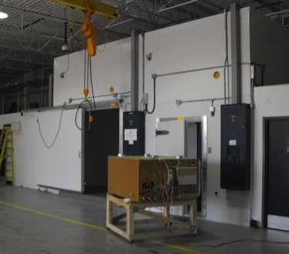
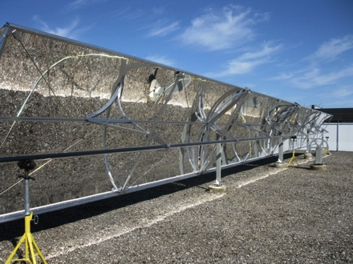
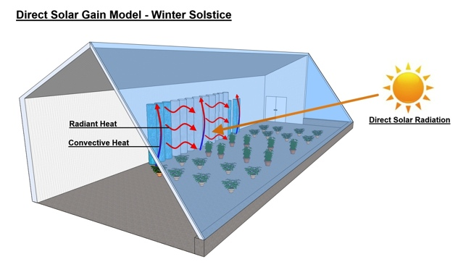
Current SITRG Projects
Large commercial/industrial building air leakage testing
Prototype Heat Recovery Ventilator performance testing
Investigation of concentrating solar power (troughs)
Assessment of thermal storage for greenhouses
Feasibility of micro-wind energy for compressed air storage

Slide 17
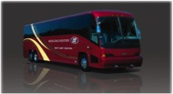
Case: Motor Coach Industries
Evolved from NSERC LAMP pilot project
Engine/transmission system design/integration for US EPA 2007
Five students, three instructors: three students since hired by MCI
Six months from idea to prototype (including US legal approval)
Met/exceeded all test requirements of all prototypes
“The nature of the outcome is a new model that sells.”
Interview with Jim MacDonald, Director of Engineering by Marcel D. Mongeon, Mongeon Consulting Inc.
Results incorporated in ~20% product sold (~400 units p.a.)
Referenced in 2007 Federal Budget http://www.budget.gc.ca/2007/bp/bpc5de.html#innovation
Four subsequent projects, including US EPA 2010 prototype
Subject of positive column about RRC-MCI relationship/mutual benefits by Martin Cash, Business Columnist, Winnipeg Free Press http://www.winnipegfreepress.com/business/rrcs-savvy-fuels-green-buses-110901159.html

Slide 18
Opportunities for R&D support
NSERC College and Community Innovation Program
  Innovation Enhancement
  Applied Research & Development (~ Engage)
  Applied Research Tools and Instruments (one-time)
  Technology Access Centre (Pilot)
  Industrial Research Chairs for Colleges (as of 2011 10 04)
  College-University Idea-to-Innovation (as of 2011 11 15)
National Research Council
  National laboratories
  NRC-IRAP SME-focussed programs and Network Member Agreements
Automotive Partnerships Canada
SR&ED: explicit eligibility for peer-reviewed NSERC collaboration programs between Post-Secondary Education and Industry

Slide 19
Answering your questions
1. What do we mean by a strategy, i.e., what are its key elements?
Support applied research to adapt, adopt and improve existing technologies and commercialize new ones
  Local SME, Solar Solutions – testing new type of heat ventilator that could significantly improve winter solar technology performance
  CARSI served as a test bed for several technologies use in Manitoba Hydro’s Downtown Office Building (Best Tall Building in the Americas)
  Extensive ground transportation work (MCI, NFI, MHI etc.)
Raise awareness and transfer knowledge
  NRC-IRAP Network Member Agreement

Slide 20
Answering your questions
2. What specific goals should we adopt as the core of a Canadian energy strategy?
Develop a national goal to increase energy-related R&D spending to ensure Canada remains competitive
  Use spending in the U.S. and the EU as benchmarks
  EU Commissioner for Research, Innovation and Technology’s ‘Horizon 2020 Plan’:
    $3.8 billion (up from $415 million since 2008) for scientific communities devoted to climate change and sustainable energy
    $17.7 billion (77% increase over 2007-13 levels) for the European Research Council, which concentrates on applied, rather than basic, research
Notes:
These proposed increases and renewed commitment to EU-funded scientific spending are impressive given the current financial turmoil in the eurozone.

Slide 21
Answering your questions
3. What are the foundational principles that should underpin a Canadian energy strategy?
Demand side:
Strategy should emphasize the need to explore and exhaust all feasible and cost-effective measures to reduce energy use and peak demand
  Reducing the need to expand the supply of energy and its related infrastructure
Supply side:
  Encourage use of renewable energy

Slide 22
Answering your questions
4. What are the key elements of an action plan to put the Canadian energy strategy into play?
Not only what should be done, but who will do it and where the resources should come from
Utilization of post-secondary and public-sector applied research capabilities should be a top consideration
Support from federal SBAs and regional economic development departments to the innovation ecosystem
  NSERC, NRC, NRCan, CFI, SDTC, WD, FedNor, ACOA, etc.

Slide 23
Answering your questions
5. Who are the main players needed to put the Canadian energy strategy into play?
Post-secondary education sector
  Ability to accelerate innovation across all energy-related sectors
  Preparing workforce for success in strategy implementation
    Technical training for new workers on latest technologies
    Upgrading skills of existing workers
  Knowledge Transfer
Public laboratories and facilities
  Applied R&D
Utilities and private-sector
  Willingness to work with public sector AND implement results

Slide 24
Answering your questions
6. What can the federal government do to facilitate realization of the strategy?
Increase support for Canadian Colleges to expand the capacity for innovation across energy-related sectors, e.g. NSERC’s College and Community Innovation Program ($40M currently)
  Innovation Enhancement
    applied research on improving the energy performance of buildings
  Applied Research Tools and Instruments
    air leakage testing (industrial buildings) and environmental chamber expansion
  Applied Research & Development
  Industrial Research Chairs for Colleges (42 applications for 18 awards)
    assess the performance of green buildings
  Technology Access Centres
  College-University Idea-to-Innovation

Slide 25

Sector-Specific Recommendations
Sustainable Transportation
  Support testing and demonstration of electric vehicle technology performance in northern climates
  Support the recommendations of Electric Mobility Canada
    Invest in the development of amendments to Codes and Standards
    Invest in Charging Infrastructure for electric vehicles
    Urge federal fleets to lead by example
    Initiate Canada’s green highway
  Support related training, e.g. first responders

Slide 26
Sector-Specific Recommendations
Sustainable Infrastructure
  Enhance support of applied research on improving the energy performance, durability, comfort, and occupant health of large buildings
  Improve performance testing, i.e. post-occupancy analysis, of new ‘green’ buildings
  Extend life of existing buildings and infrastructure

Slide 27
Recommendations
Sustainable Manufacturing
  Applied research into sustainable processes and technologies
  Assist with resources to train and implement best practices
  Encourage industry to capitalize on opportunities
  Alternate Energy
    Encourage manufacturer investment in developing new technologies and products in support of energy savings
      Ground source heat pumps, photo-voltaics, wind turbines, etc.
    Long-term strategy needed
Notes:
1. Sustainable Manufacturing – There are many opportunities for firms to implement sustainable manufacturing practices in their manufacturing processes, which has a positive impact on the 3 Ps: People (personal health and safety), Planet (environmental impact) and Profit (save money through energy efficiency). Perhaps the feds could place more emphasis on this and provide resources to train and implement these practices in manufacturing, which will ultimately reduce our energy consumption and improve environmental impacts.
2. Alternate Energy – Perhaps there is an opportunity for manufacturing to take advantage of developing new products and technologies in support of ‘clean energy’. If the feds can come up with a long term strategy related to the environment, then manufacturing could consider investment in developing new technologies and products in support of energy saving and alternate energy products. This could develop into a new manufacturing sector involving ground source heat pumps, solar energy, wind energy generation, etc. The ‘conflict’ in MB is the artificially low electricity rates which do not reflect the market place, and does not provide enough return on investment. Either the Province raises the rates and/or the feds provide subsidies to assist in development and commercialization of these technologies.

Slide 28
Thank You
Ray Hoemsen, M.Sc., FEC, P. Eng.
Director, Applied Research & Commercialization
Red River College
Winnipeg, MB
(204) 632-2523
RHoemsen@rrc.mb.ca
Website:www.rrc.mb.ca/appliedresearch
Blog: http://blogs.rrc.ca/ar/
Twitter: @RRCResearch

