Slide 2
Pre-Retirement Information Session

Slide 3
Thinking of Retiring?
Consider the following:
When to retire – this is a personal decision; no one time is best for everyone. We encourage speaking with financial advisors to determine what is best for you!
Ask your Pay and Benefits Specialist for an estimate of your vacation/severance pay (have a tentative date in mind)
Start thinking of how you are going to handle your vacation/severance pay
Retiree Benefits on our blog site at https://rrc.ca/hr/information/pension/
You may request a retirement package from CSSB (including all forms) within 6 months prior to retirement date. The earlier you complete the forms and return to CSSB the smoother the transition from work to retirement will happen. CSSB has indicated that they require the forms 4 – 6 weeks prior to your date of retirement in order for you to receive your first pension deposit on time. Documents not submitted within 30 days after retirement may cause serious issues with your options and will result in missed payments. A meeting with a member of the CSSB is not required, but is highly recommended.

Slide 4
Severance (Retiring Allowance)
As per the Collective Agreement:
Employees who retire with nine (9) or more years of continuous employment shall be paid severance pay in the amount of one (1) weeks’ pay for each complete year of continuous employment or portion thereof, but the total amount of severance pay shall not exceed fifteen (15) weeks.
Is also eligible to receive 2 additional weeks as follows:
with 20 or more years of service , for a maximum of 17 weeks pay
with 25 or more years of service , for a maximum of 19 weeks pay
with 30 or more years of service , for a maximum of 21 weeks pay
with 35 or more years of service , for a maximum of 23 weeks pay
with 40 or more years of service , for a maximum of 25 weeks pay
Example: employee retiring with 27 years of continuous employment will be awarded 15 weeks pay plus 2 additional weeks for 20 years of service and 2 more weeks for 25 years of service for a total of 19 weeks pay.

Slide 5
Severance (Retiring Allowance)
THINGS TO CONSIDER:
Transfer funds to RRSP or Cash out?
If you are transferring to an RRSP, you will require a Notice of Assessment (NOA) from current Income Tax filed (can be obtained from Canada Revenue Agency (CRA)
Employee must terminate from all positions at the college in order to transfer funds to an RRSP, if using the Retiring Allowance (see next page for interpretation)
**It is the responsibility of the employee to advise all other departments they currently work under, of their official retirement date** e.g. Continuing & Distance Education

Slide 6
Severance (Retiring Allowance)
Retiring allowances are reported on the T4 slip.
A retiring allowance (also called severance pay) is an amount paid to officers or employees when or after
they retire from an office or employment, in recognition of long service or for the loss of office or
employment.
If a retiring allowance is paid to a resident of Canada, income tax is deducted from any part paid directly to
the recipient using the lump-sum withholding rates.
Transfer all or part of the retiring allowance **eligible retiring allowance on the Retirement Estimate**
There are situations when a person can transfer all or part of a retiring allowance to a registered pension plan
(RPP) or a registered retirement savings plan (RRSP). For more information, go to Transfer or a retiring
allowance at
www.canada.ca/en/revenue-agency/services/tax/businesses/topics/payroll/completing-filing-information-returns/
t4-information-employers/special-situations/transfer-a-retiring-allowance.html

Slide 7
If you wish to cash out all or a portion of your severance payment, these are the applicable tax rates:
Under $5, 000.00 = tax deducted @ 10%
$5, 000 - $15, 000 = tax deducted @ 20%
Over $15, 000 = tax deducted @ 30%

Slide 8
Vacation Carry Over for Retirement
(Policy H7) - Main points to remember:
Carryover amount cannot exceed annual vacation entitlement
The maximum time period for carryover for retirement purposes is 5 years. As soon as 1 day is set aside, retirement should fall within 5 years.
Combined total of carryover and earned vacation credits cashed out at retirement should not exceed 362.5 hours (50) days
If an employee requests to change their date of retirement or requests to withdraw their notice of retirement, they must submit the request in writing including the reason for request to their Dean

Slide 9
Vacation Carry Over for Retirement
CSSB Pensionable earnings include vacation pay paid on termination, retirement or death, up to the lessor of:
2 years of normal vacation accruals, being the annual accrual rate in the fiscal year of termination, death or retirement plus the annual accrual rate in the prior fiscal year, or
Example: Vacation entitlement of 20 days per year, maximum of 40 days’ vacation cash out subject to pension deductions, any unused vacation days over 40 days will be cashed out not subject to Pension deductions
50 days.
Example: Vacation entitlement of 44 days per year, maximum of 50 days’ vacation cash out subject to pension deductions, any unused vacation days over 40 days will be cashed out not subject to Pension deductions
*Note that the maximum accrual rate is reduced proportionately if the employee worked on a part-time basis in either of the two fiscal years prior to termination, death or retirement.*
This provision does not limit the number of days of vacation that can be paid out, only the number of days of vacation pay that can be included as CSSB pensionable earnings.
Should you have more than the allotted CSSB pensionable vacation as outlined above, payment of these hours will be made upon termination.
Teachers Retirement Allowance Fund (TRAF) members do not have the option for pensionable vacation payout upon retirement.

Slide 10
Vacation Carry Over for Retirement
Transfer funds to RRSP or cash out?
If you are transferring to an RRSP (net pay after applicable deductions), you will require a Notice of Assessment (NOA) from most recent Income Tax filed (can be obtained from Canada Revenue Agency (CRA))
Amount being transferred will be the balance after pension contributions and applicable statutory deductions (CPP & EI), your NET pay.
**It is the responsibility of the employee to advise the other departments they currently work under, of their official retirement date**

Slide 11
Vacation Carry Over for Retirement
Should you wish to put vacation aside for retirement, this is now done as a Maestro process. Please go to your main HUB page
*note this is not considered your official retirement notification*
Look under My Applications
Click on the Maestro
Under My Processes please locate the Human Resource Services eForms (MP014)
Type of request will be ‘Vacation Carry Over for Retirement Purposes’ and complete accordingly.

Slide 12
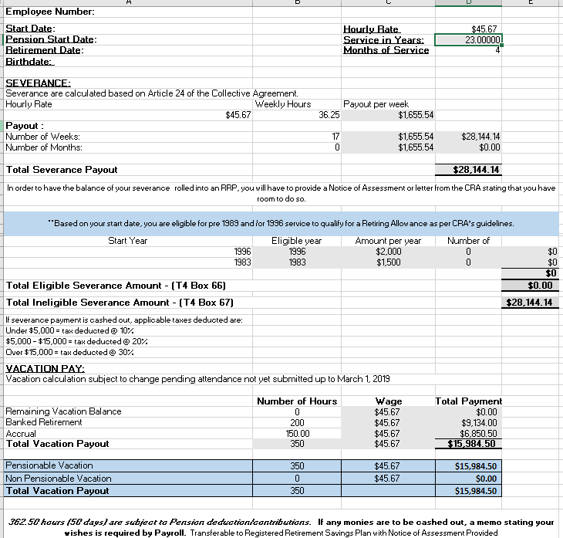
Sample of Retirement Estimate

Slide 13
Retiree Benefits
On the RRC Microsite please go to https://rrc.ca/hr/information/pension/ for Retiree Benefits details
4 Canada Life options to choose from:
1. Ambulance/Hospital coverage
2. Ambulance/Hospital & Extended Health coverage
3. Ambulance/Hospital & Extended Health & Basic Dental coverage
4. Enhanced Coverage
Your personal circumstances (number of dependents) will determine the cost.
Pay & Benefits will provide you with a copy of the Canada Life Retiree Application form within your retirement package.

Slide 14
Retiree Benefits
Submit application to HUB STRATA
Standard Application – whether or not enrolling
Payments are done through Pre-authorized Debit
Retiree Health Plan Account (NEW Policy# 160978); please destroy all other benefits cards
Current RRC Health Benefits will cease on last day of work if declining Retiree Benefits or, if you opt into Retiree Benefits, the last day of the retiring month
Contact HUB International: toll free at 1-844-984-9456 or
email: RRCretiree@hubinternational.com

Slide 15
Once a decision has been made
Contact CSSB/ TRAF
Pay & Benefits Specialist (PBS)
Retirement Package
Human Resource Consultant (HRC)
Submit in writing to Manager/ Director/Chair/ Dean
Employee
Employee
EXIT Maestro
OVERTIME BALANCES

Slide 16
Retirement Package from Pay and Benefits
Retirement Estimate – Severance and/or Vacation Pay
Forms :
- Transfer of funds to RRSP (Severance and Vacation Pay)
- Waiver Notice of Assessment for RRSP Transfer
- Acknowledgement Upon Retiring from Red River College
- Acknowledgement Upon Accepting Re-Employment with Red River College Following Retirement
- Retiree Health Benefit Options, Information and Application
- CSSB Group Life Insurance change
Pay and Benefits Specialist may also discuss
- Parking deductions
- Donations
- Remaining VRWW balances

Slide 17
The Big Day!
RRC staff ID card – return to HR
Ensure all Retirement Package forms/documents are submitted to Pay & Benefits
Final payment of Severance/Vacation will be made the pay period after your final regular earnings
Ensure SIN card is updated with current surname
Advise your service providers (pharmacy, dentist, massage, physio) of benefit plan number change
Address, phone or email changes should be communicated to Payroll to ensure your T4 is sent to the correct address if you have moved, or relocated to another province/country
As a retiree of RRC, you will still have access to the Homewood Health (EFAP) program. https://homeweb.ca/ (login setup required

Slide 18
Thank you for your time
Questions? Comments?
If you have any questions, contact Human Resource Services
204-632-2319
paybenefits@rrc.ca

