Slide 1
Business Source Complete
Notes:
Welcome to the Library’s Lunch and Learn session on EbscoHost’s Business Source Complete academic database.
The Lunch and Learns are an ongoing series of mini-lectures on a variety of research based topics and databases. Please check the Lunch & Learn page at Library.rrc.ca for more information.
Let’s get started.

Slide 2
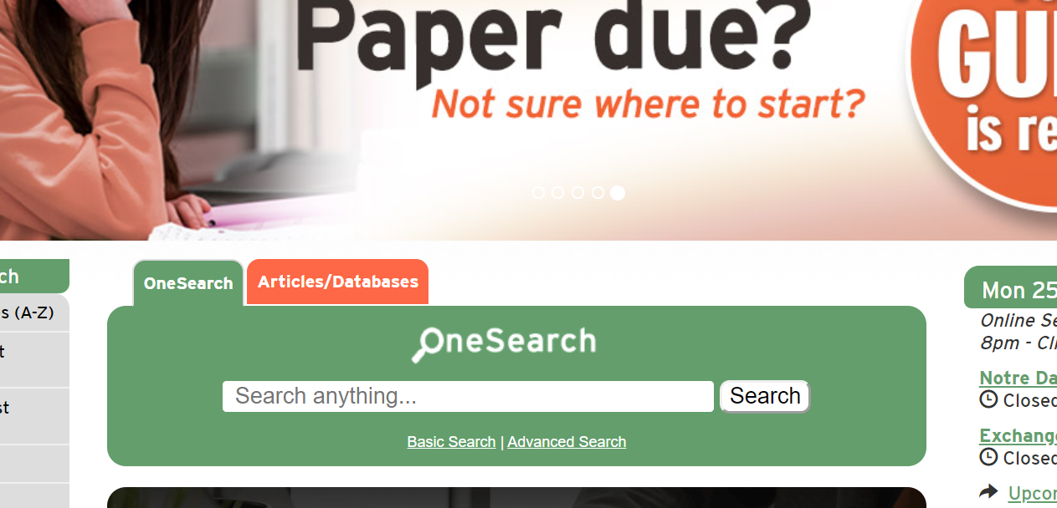
Notes:
To access the Business Source Complete database, go to the Library home page at rrc.ca/library. Near the center of the page is a tab for Articles and Databases. Click on this tab.

Slide 3
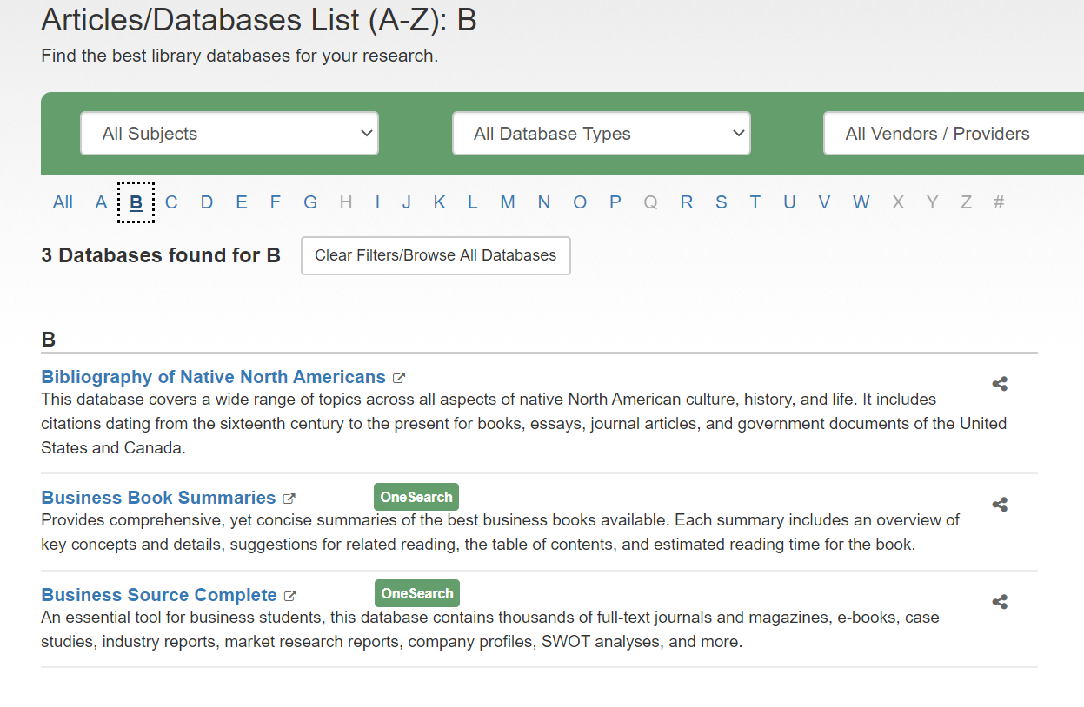
Notes:
In order to use the database, you must access it through our Library web page. We subscribe to the database and it is only available to registered Red River College staff and students. Once you are at the Articles and Databases page there are several ways to access Business Source Complete. You can search by clicking on the letter ‘B’ and all databases beginning with B will appear; then click on Business Source Complete.

Slide 4
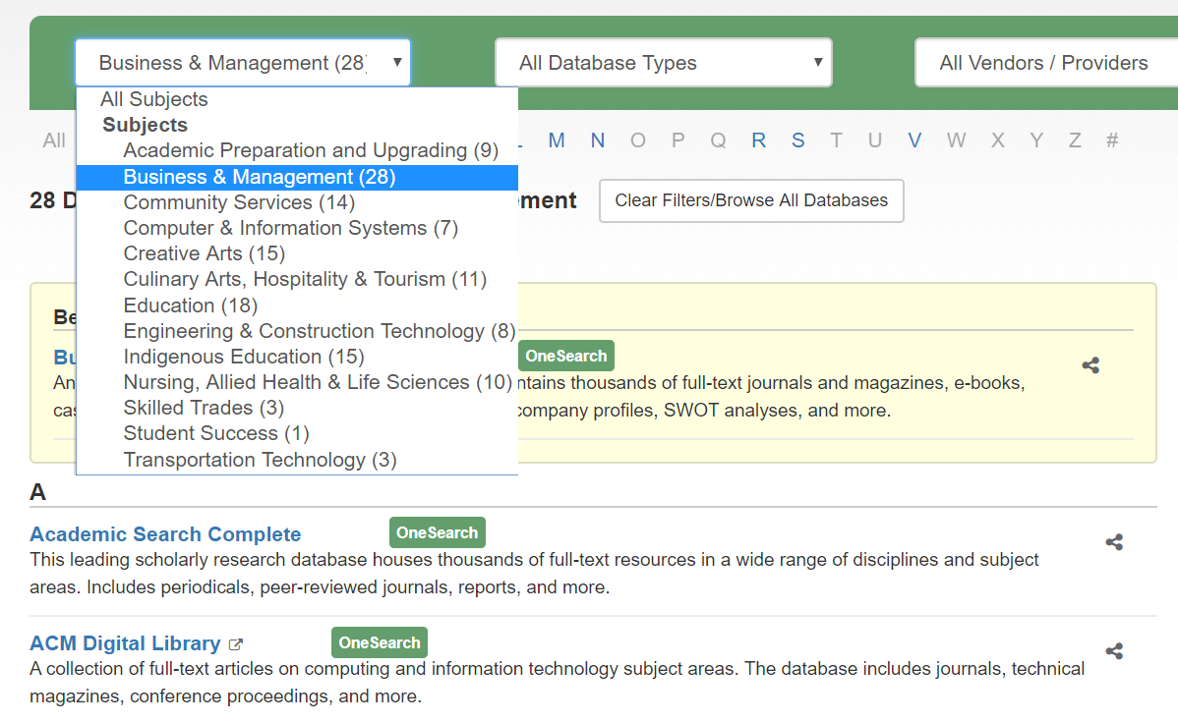
Notes:
Alternately, you can open the ‘All Subjects’ box and select Business & Management. All databases containing substantial information on business, management, economics, and related topics will appear. From this list, locate Business Source Complete and click on it.

Slide 5
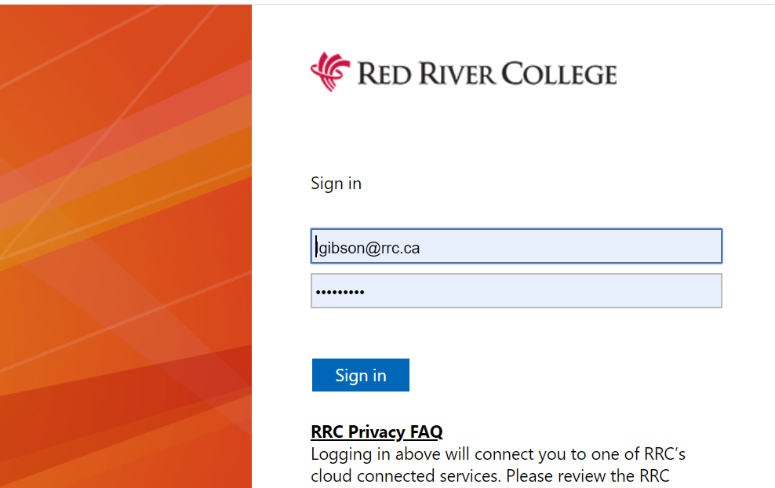
Notes:
You will be asked to log in to the RRC Library databases using your HUB username and password. If you are unsure of your username or password you can contact the IT Service desk by phone at (204) 632-2125 or by email at servicedesk@rrc.ca.

Slide 6
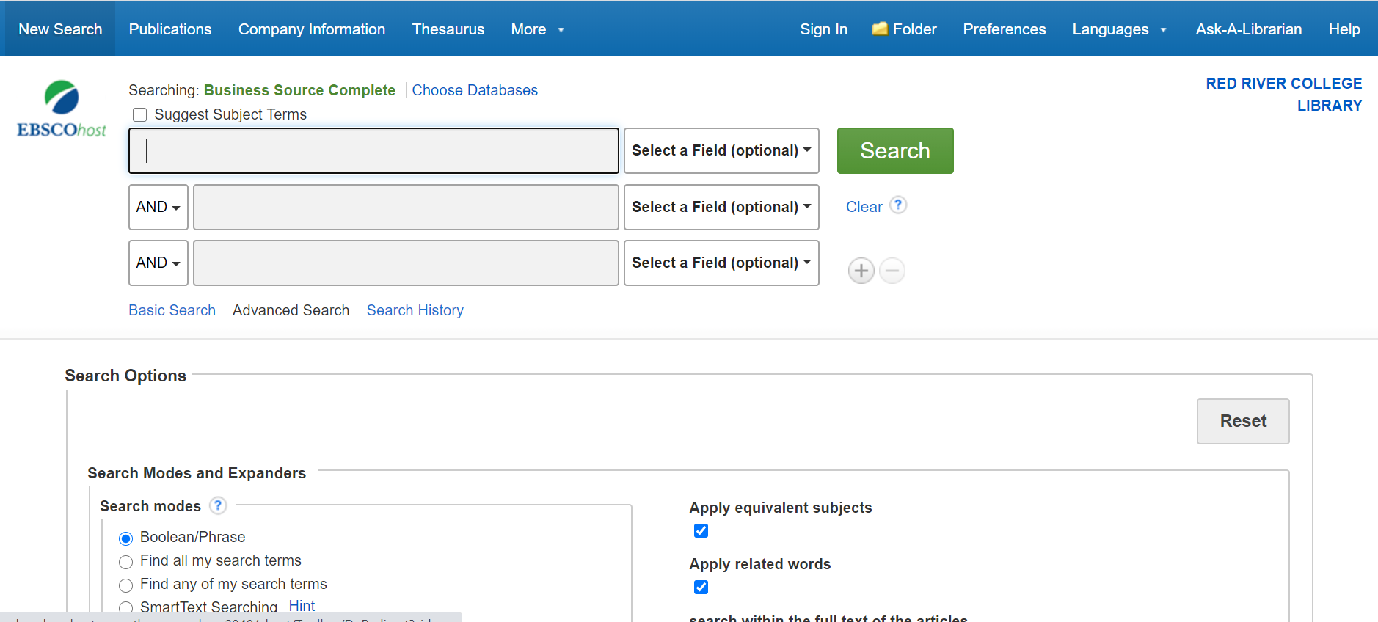
Notes:
When you arrive at the search screen for Business Source Complete you will see it is set to the Advanced Search. There is also a Basic Search and a Search History option. This tutorial shows you how to search the Advanced Search as it is robust yet easy to understand. We are seeing only the top of the search page; there is more to see if you scroll to the bottom of the screen, including many limiters.

Slide 7
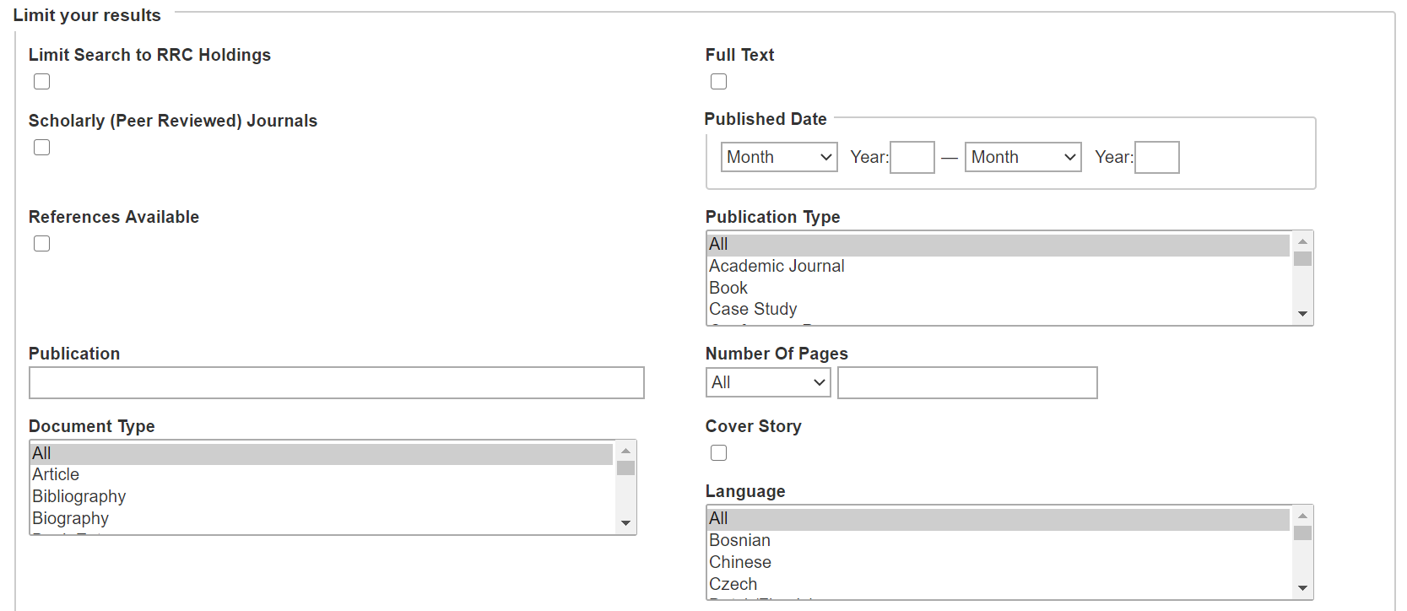
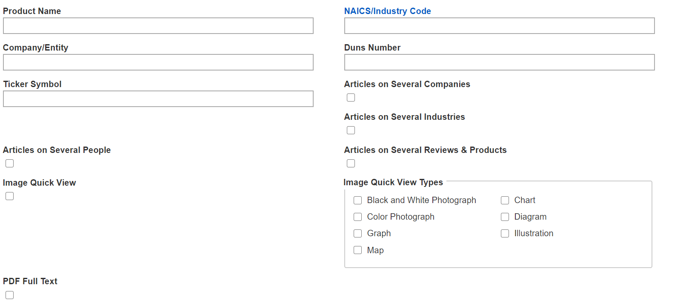
Notes:
There are almost too many limiters to list here but some of the most important are Full Text, which will cause your search to only retrieve articles with full text available for immediate viewing; Publication Type which includes options such as Case Study, Country Report, Industry Profile, Market Research Report and many others; Document Type, such as Biography, Company Report, Product Review and more; North American Industry Classification Number; DUNs Number; Ticker Symbol; and Image Types, among others.

Slide 8
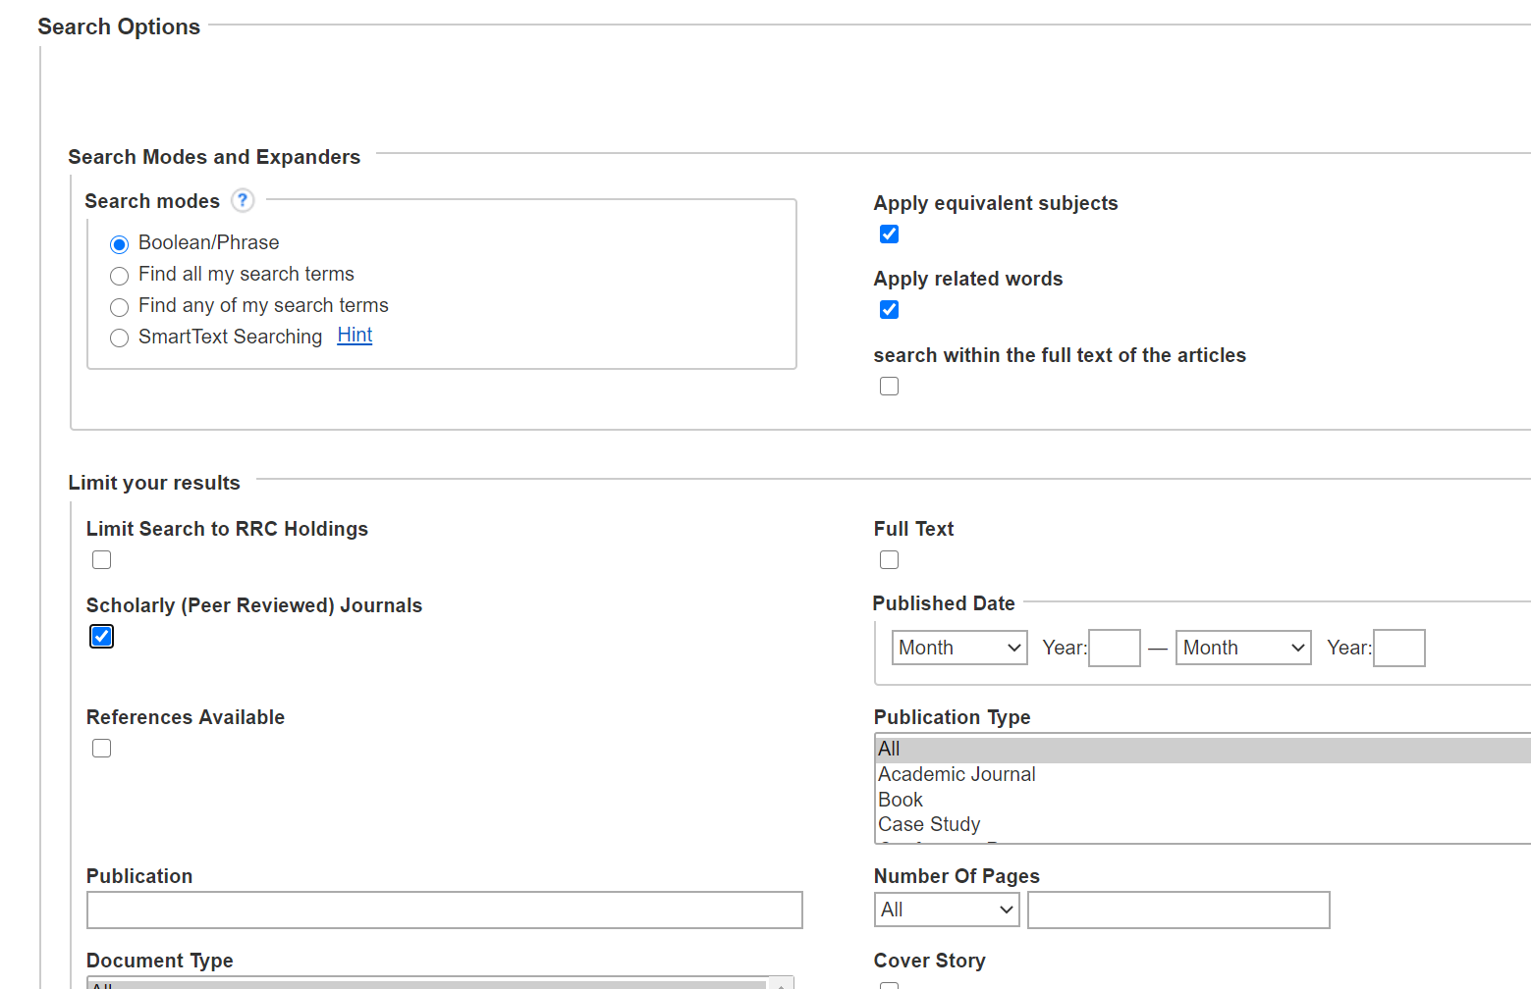
Notes:
At times you may be required to find ‘scholarly’ or ‘peer reviewed’ journal articles. When instructors ask you to use these sources, they want articles written by scholars with known credentials and affiliations, and which are reviewed by a board of experts in the field. The articles may contain studies, research findings, theories, news or summaries of current knowledge, include citations and be intended for a scholarly audience.

Slide 9
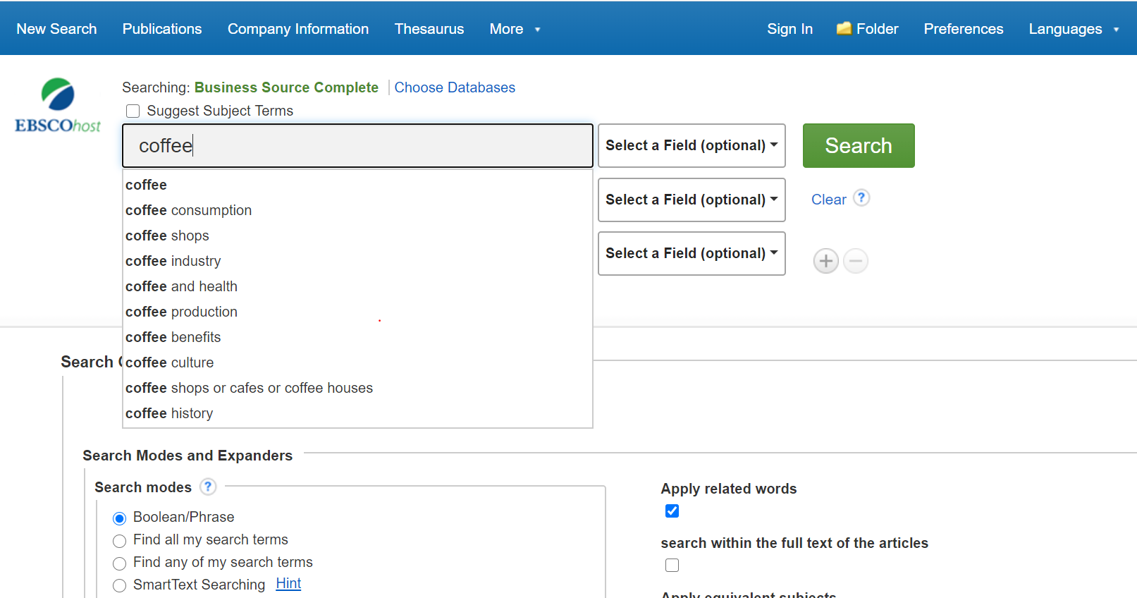
Notes:
Let’s start a search to find information about coffee shops. We'll click on the first search window and start typing coffee for example. Before we get to the end of the word, the database starts to give some suggestions to make the search easier and more specific. We see ‘coffee consumption’ which might be valuable for marketing, ‘coffee production’ which might give information about the industry, and ‘coffee shops or cafes or coffee houses’ among others. We will click on coffee shops….

Slide 10
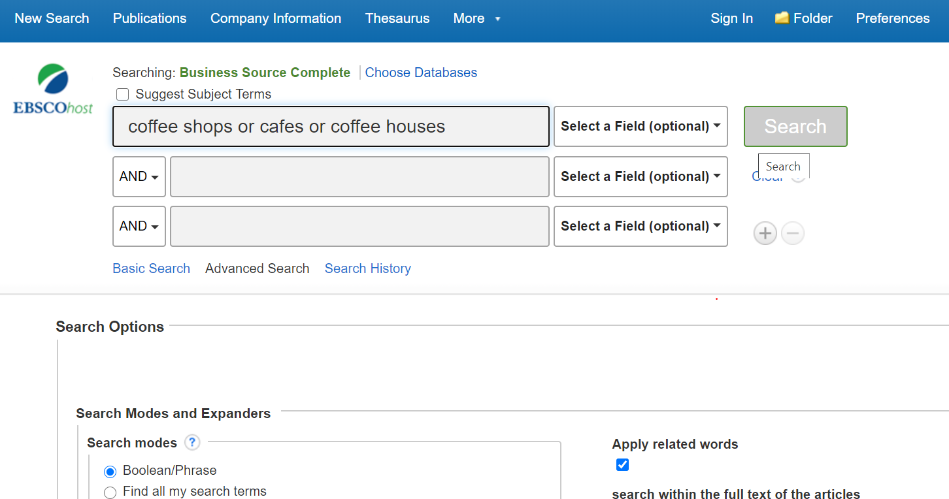
Notes:
Once we click on the coffee shops suggestion it is inserted into the search window and we can then simply click on the Search button to retrieve a list of results. The results list will include business journals, trade journals, newspapers, reports, books, market research reports and other source types.
It is important to talk for a moment about the search string we selected. You will notice it has different terms linked by the work OR. The terms And, Or and Not are what are called Boolean Operators, which give the database specific instructions on how to search. For more information you can view the Research Skills Lunch & Learn presentation. For now we will click on Search to view some results.

Slide 11
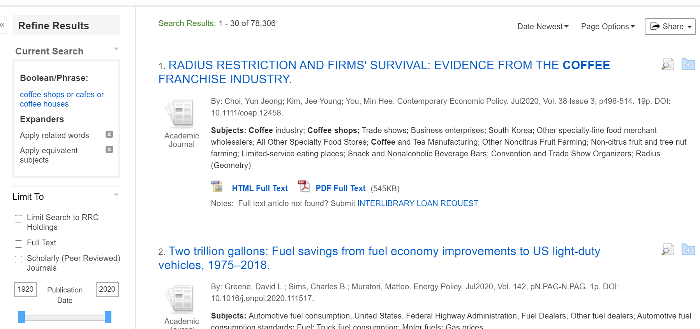
Notes:
The Results list appears below the search window. You see the total number of results retrieved by your search term or terms and the first 30 display on the screen. These include all results that have a subject, title word or keyword from the search you typed in. So, this list has records containing the words cafes or coffee, or the phrases ‘coffee shops’ or ‘coffee houses’. We haven’t limited to only full-text articles, so we will see some that are citations only, without the entire article attached. There are over 78,000 results at this point. They are from all document types and may or may not contain specific information we are looking for. However, we’ll examine the first record here to see what information comes up in each record.

Slide 12
Each of these subject are links to all other articles tagged with that particular subject.
There are different types of Full –Text information available in different articles.
HTML full text is available by clicking on the link, or by clicking the title link.
PDF Full-Text retrieves the Full-Text as it appears in the original publication.
Linked Full-Text takes you out of the Business Source Complete to another Ebsco database, or another online service that contains the information.
Notes:
Each short record in the Business Source Complete database contains similar information. You will see the title of the item, which is a link to the full record that we’ll look at soon. Bibliographic information below the title includes the author or authors; the source, such as the journal, newspaper, or other publication that contains the article; the date of publication, including day, month and year as applicable; the pagination, including the number of pages; and more.
Below this are the subjects that have been assigned to this article, so that it is more easily discoverable by searching. These subjects are links to all other articles tagged with that particular subject (kind of like hasthtags). They also give you good clues to what the article is about even before you view the full-text.

Slide 13
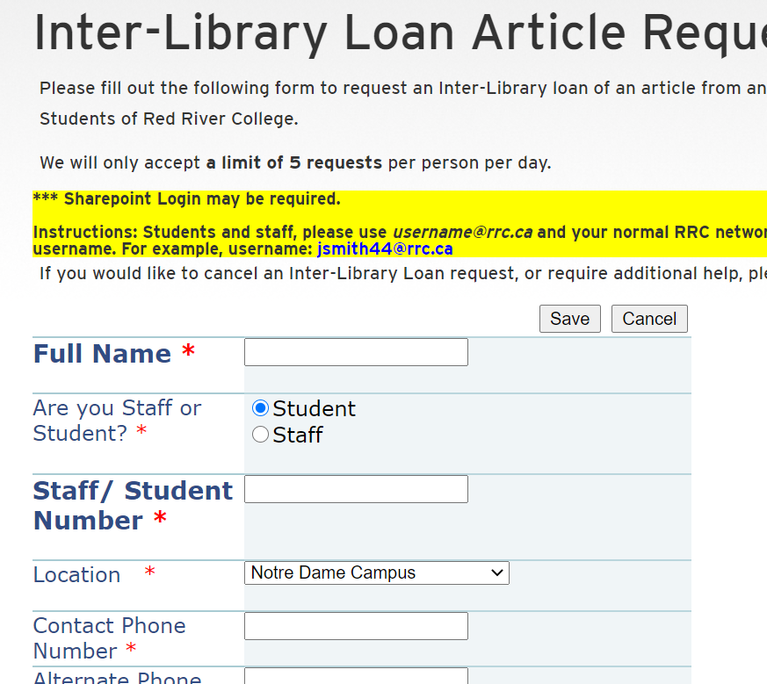
Hover over the magnifying glass icon to quickly view the abstract of the article, to see what it contains.
Click the folder icon to add this record to a saved list you can print or email at the end of your current session.
Notes:
The magnifying glass icon allows you to quickly view the abstract of the article. This summary can help you determine if it suits your purposes, without opening the full article. Hover over it to activate this view.
Click the folder icon to add this record to a saved list you can print or email at the end of your current session. These saved files will be available for this session only. You can create an account within Ebscohost to save articles between sessions, or save searches you can rerun anytime. Chat with us online and we can walk you through how to set this up.
If there are no Full-Text links in an article that you really need, click on the Interlibrary Loan Request link and fill out the required fields. We will try to get it for you. https://library.rrc.ca/Services/ILL-Article-Request.aspx

Slide 14
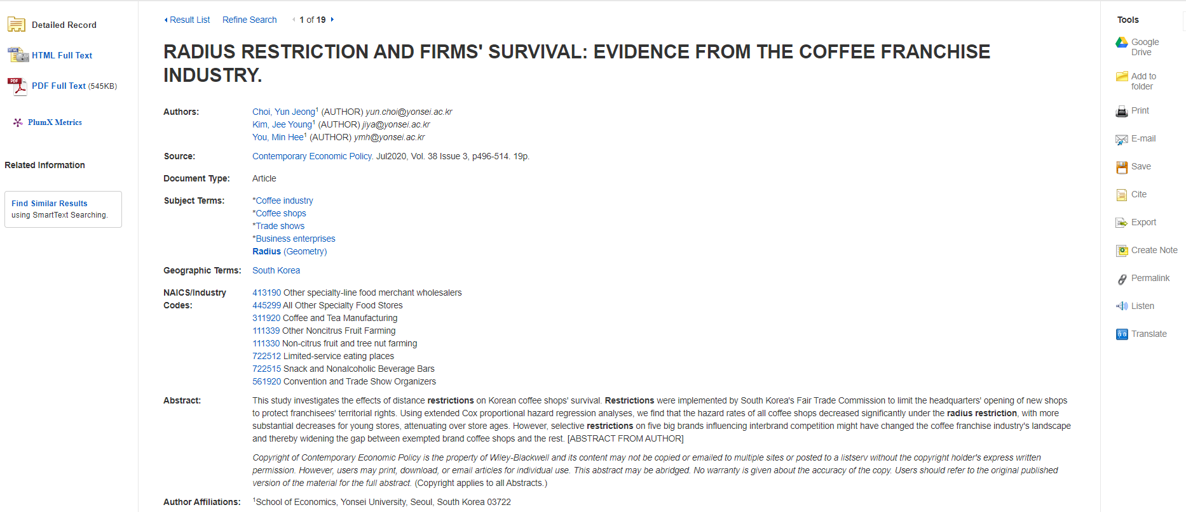
Notes:
After clicking on the title link we see the entire record, including HTML Full Text if included and/or links to PDF Full-Text. You get all the same information from the brief record, but much more, including NAICS codes which are clickable, and the abstract. The next slide shows more information farther down the record…

Slide 15
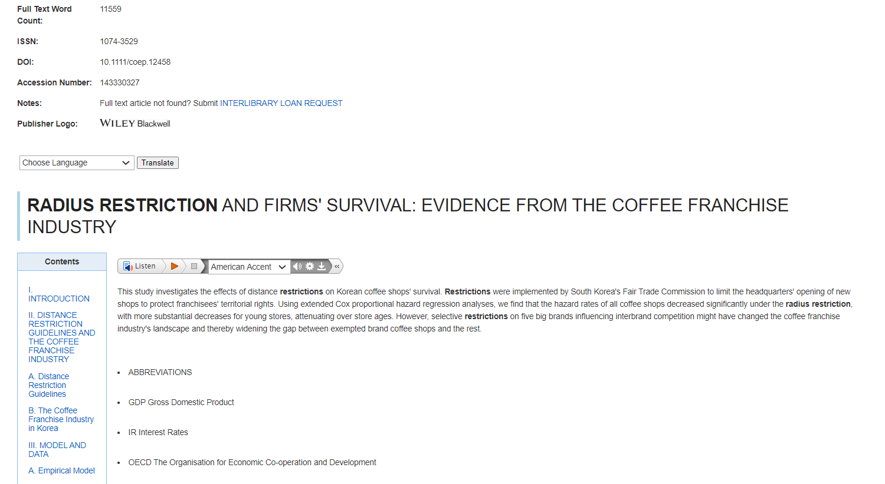
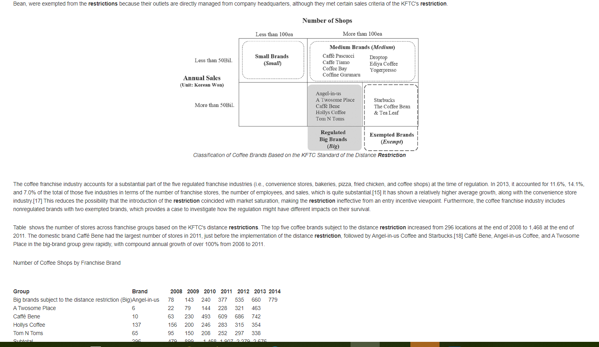
Notes:
Here we see the word count of the article, and then the HTML Full-Text if included. There is an option to have the article read out loud, and links to jump to various sections in the article. This particular article contains graphics and charts, just as the original would show.

Slide 16
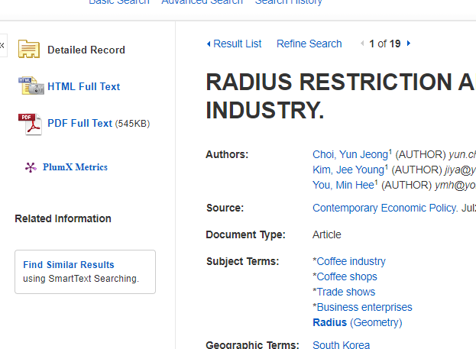
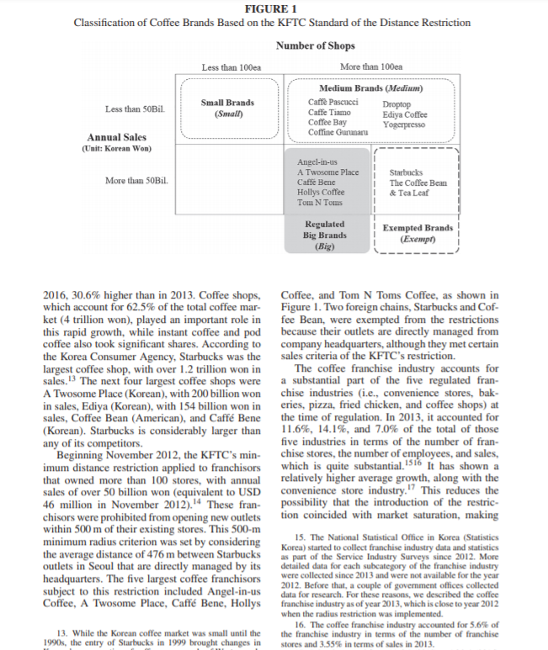
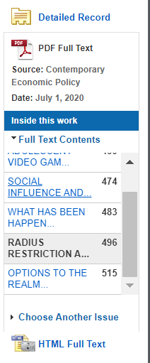
Notes:
If you click on the PDF option from the top of the full record, this version comes up. You can actually look at more articles from the journal by using the links on the left side of the article view.

Slide 17
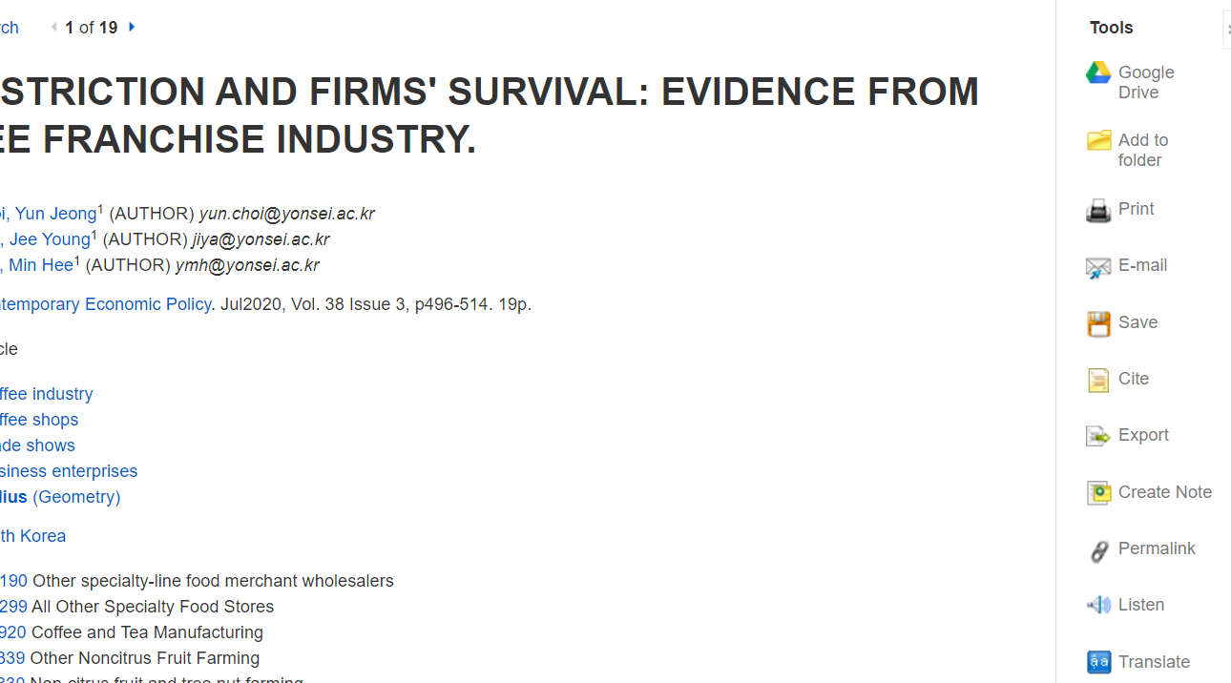
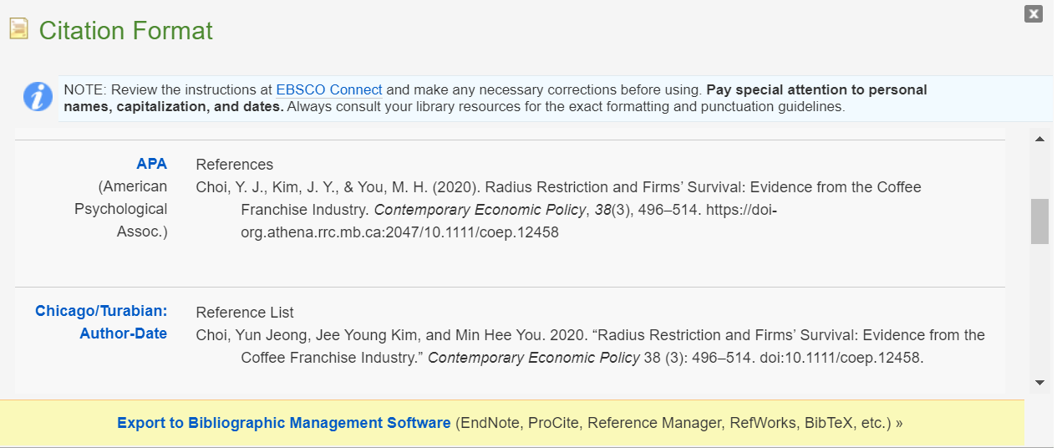
Notes:
To the right of the full article view you see a toolbar which allows you to Print, E-mail or Save the article. Of particular interest is the Cite option, which allows you to select and copy a particular citation format for the article as shown here.
The Permalink is an enduring electronic location of the article that you can include in references, send to instructors or share with other students when working in teams. This permalink may need to be included in certain citation styles, such as APA.

Slide 18
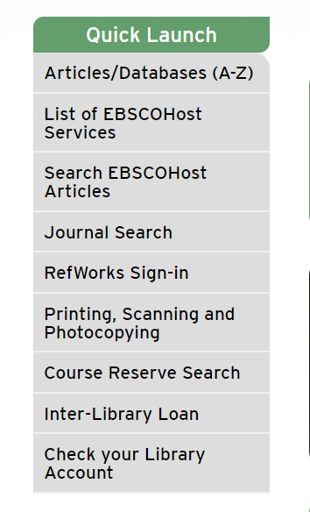
Notes:
This is a good time to mention that the Library has access to RefWorks. You can export Business Source Complete citations you find into RefWorks. You will need to create a RefWorks account first. The Library has a guide to help you with RefWorks available at https://rrclibrary.libguides.com/refworks.

Slide 19
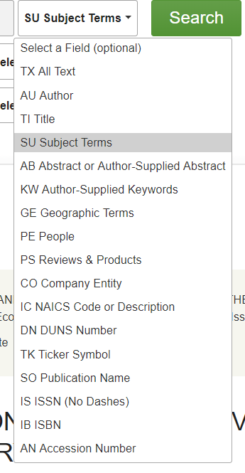
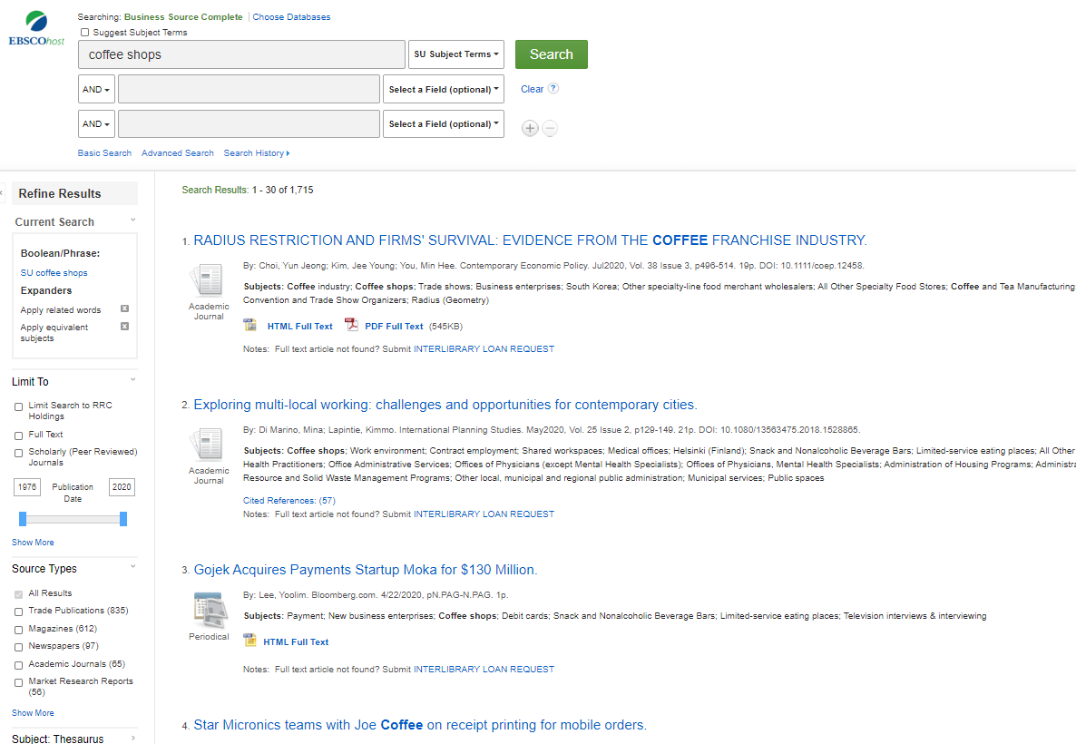
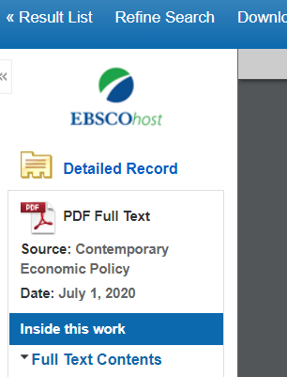
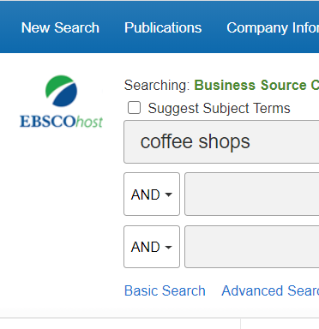
Notes:
This is an example of a new search for ‘coffee shops’. In this case we modified the search from keyword, to find coffee shops in the Subject Field only. There are a wide variety of ways to make your search more specific by using the pull down menu. Our first super-general search brought back over 78,000 results… way too many to look at. This more specific search has retrieved just over 1,700, much more manageable and specific.
You can go back to the search screen at any time. From the pdf view, go back to the Results list and then scroll up to modify your search, or select New Search from the blue bar at the top left of the screen.

Slide 20
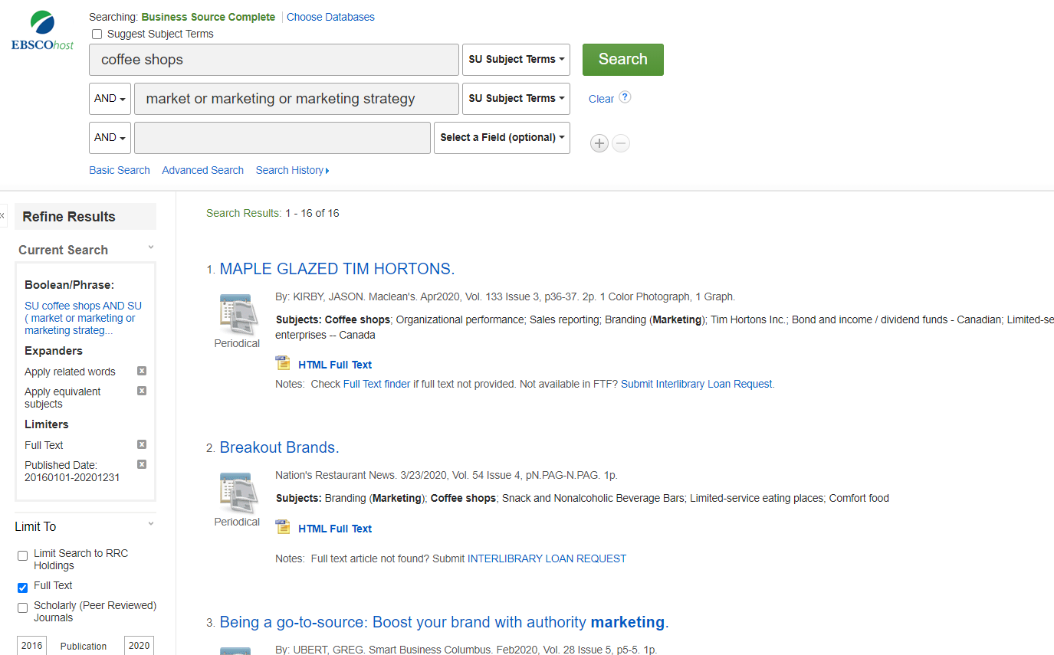
Notes:
There is a lot going on in this search. First, we are still looking for coffee shops in the first search window and want that phrase as a subject term. We’ve also added more terms on the second line. We want the article to not only have a subject of coffee shops, but to also have a subject word of either Market, or Marketing, or Marketing Strategy. We are using Boolean logic here and you will notice that the two search windows are connected by the Boolean ‘AND’ operator. If we didn’t want any articles about marketing, etc. we could change this to a NOT and exclude any articles containing a subject of marketing.
We also clicked on the Full Text limiter, to only retrieve articles with text immediately available to us, and we limited the date range to 2016 or newer. The database is set to display articles newest first, but this date range will exclude older ones. Now our number of results is only 16.

Slide 21
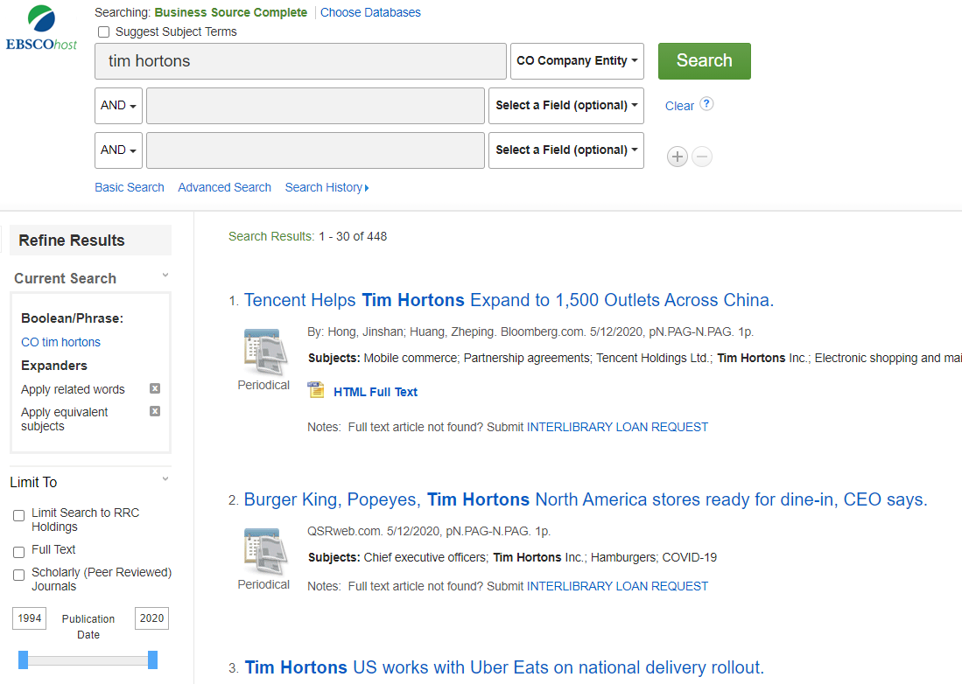
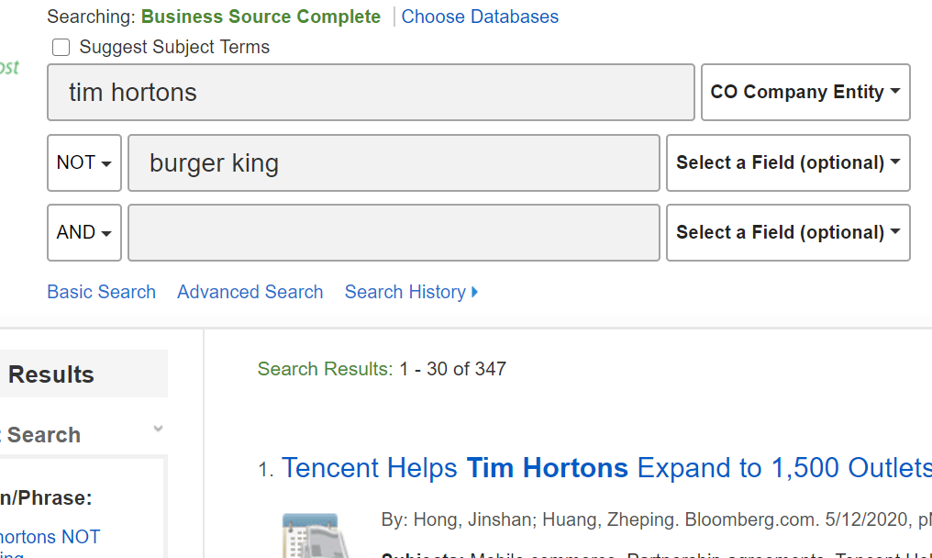
Notes:
Next let’s look at searching for a specific company. We’ve typed in Tim Hortons and changed the search field to be CO Company Entity, which retrieves articles specifically about Tim Hortons Inc. There are 448 results. To show how we an exclude articles, the inset search uses the NOT operator to exclude any articles with Burger King appearing. This weeds out 101 articles and gives us 347 results.

Slide 22
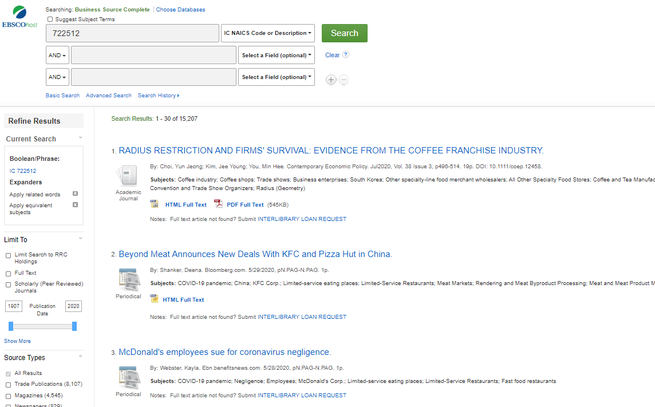
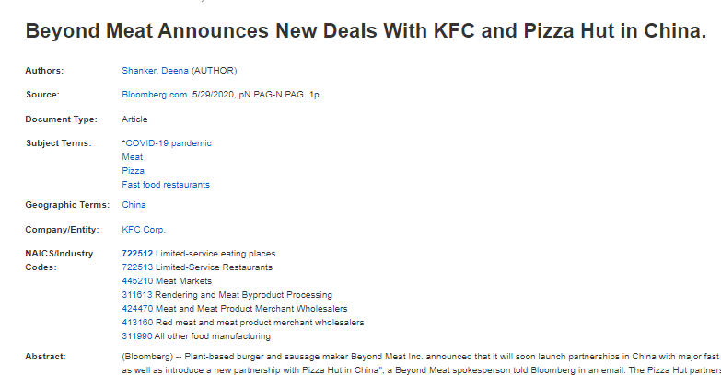
Notes:
If we want to search for a specific industry by the NAICS (North American Industry Classification System), we can type in the industry code number and select the NAICS options – all records will have content related to that industry. You will see it shown in the detailed record. If you need help finding industry codes you can search online or contact us through LibChat.
At the top of the page we will click new search and look at some menu options for searching in the blue bar…

Slide 23
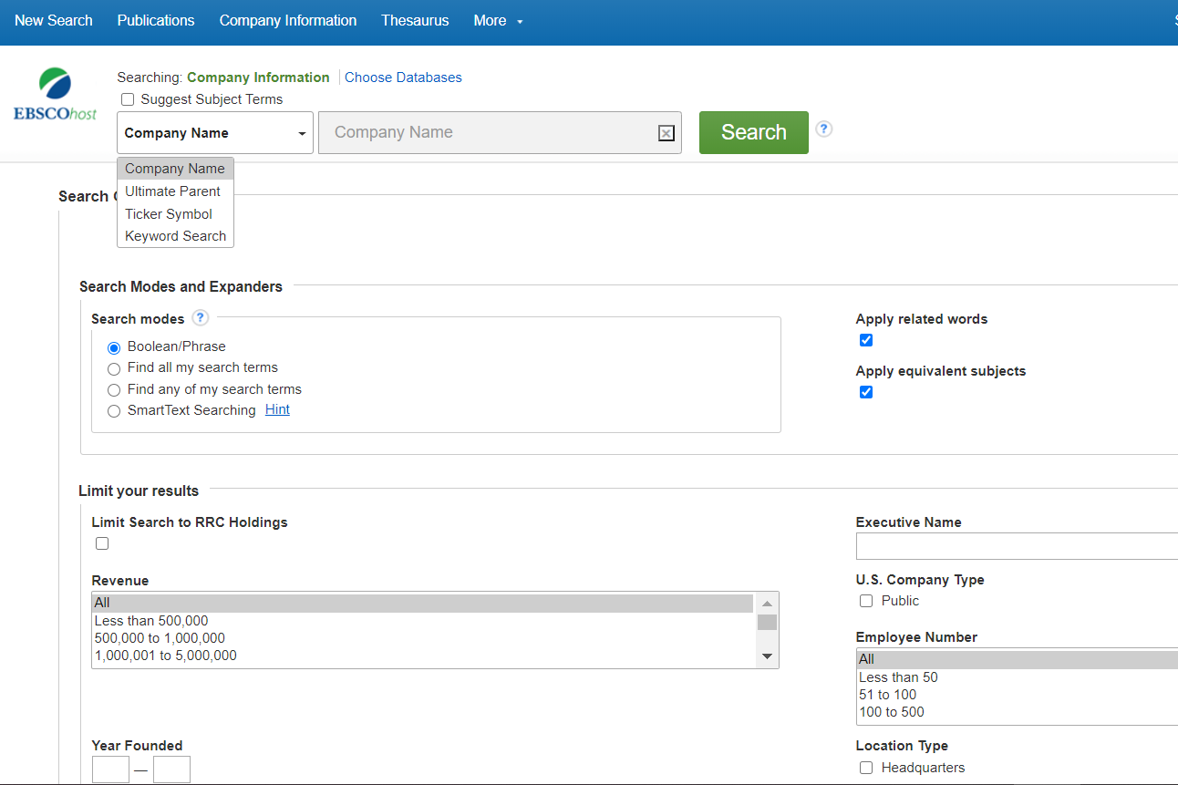
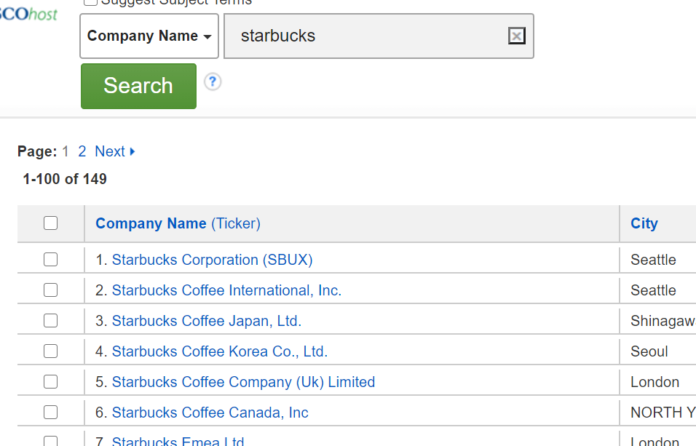
Notes:
The Company Information Search is very handy. Click on the Company Information link in the blue bar and you will see options for searching, such as Company name, Ultimate Parent Company, Ticker Symbol and Keyword Search. You can limit by revenue, number of employees, location, and many more options. When you’ve made your selections, a list of options will show.
Here we’ve chosen Company Name and typed in Starbucks. We’ll click on one of these company names to see what come up.

Slide 24
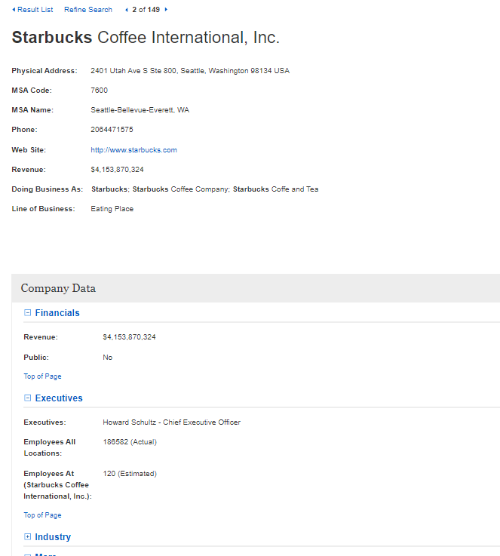
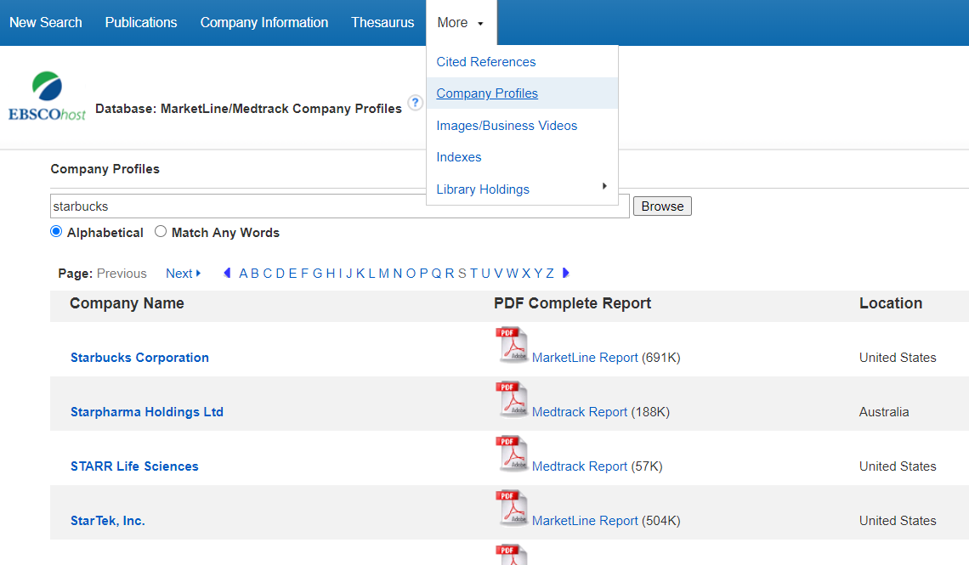
Notes:
You see information about Revenue, Executives, Industry affiliation, and more. This is helpful, but if we want a more detailed look at a company we can click on the More button in the blue bar. Select Company Profiles from the options, type in the company you are interested in, and click Browse. Then, select the option you want. This search is an efficient way to find a Marketline Report on companies which will provide a wealth of information. Some of the companies have a Medtrack report which gives 3-4 pages of information on medical or pharmaceutical companies. Let’s look at the Starbucks’ Marketline report…..

Slide 25
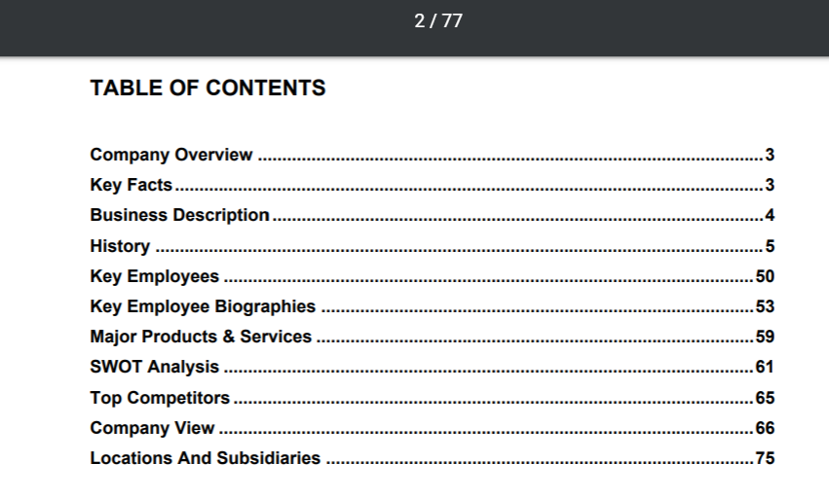
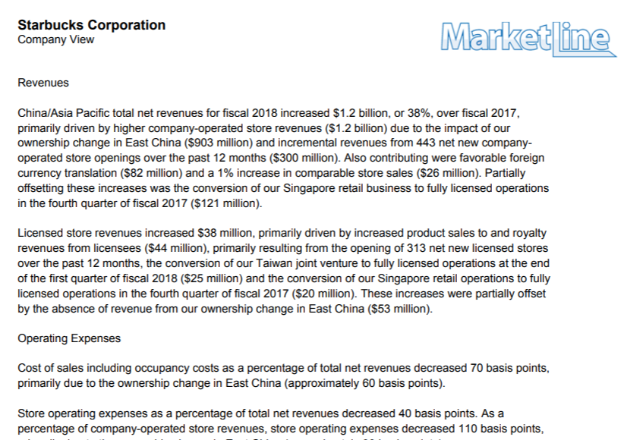
Notes:
In this case the Marketline Report is a 77 page document full of valuable information. You can browse through it, or look for the download option, to save it. You can get a detailed history of the company, biographies of key employees, SWOT analysis, competitors and much more. It really is an easy way to locate this data.

Slide 26
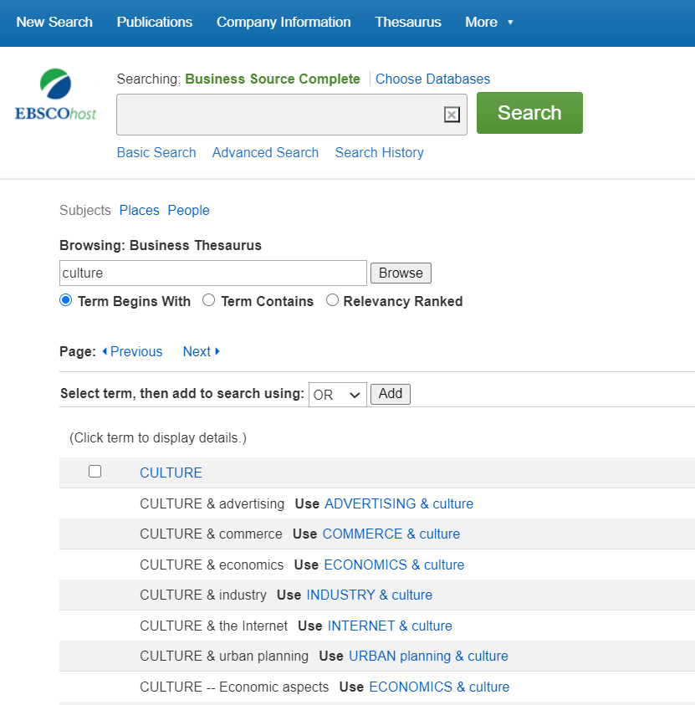
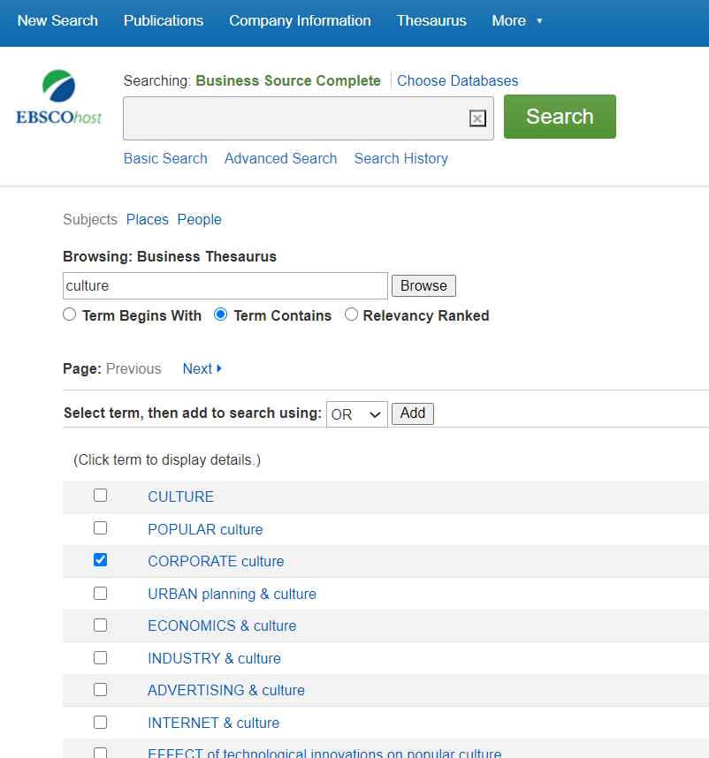
Notes:
Finally, we’ll have a quick look at the Thesaurus in Business Source Complete. Click on Thesaurus in the blue bar. You will see a Search box at the top, and a Browsing window just below that. The Thesaurus allows you to type in a search word or phrase and see what subject terms (or descriptors) are in the database. For an example here we’ve typed in the word culture. You can select if the Term begins with that word, or if that Term is among other words as a descriptor phrase.
In the first example the default is to have your Term as the first word and we see a list of subjects in alphabetical order. This is a good example of how the database refers us to alternate subjects. The second example shows the difference when we ask for ‘Term Contains’ the word we are searching for. We’ll select ‘Corporate Culture’ by checking the box beside it. We can then click on the Search button to see all the results. If we want more information about any term, we can click directly on it.

Slide 27
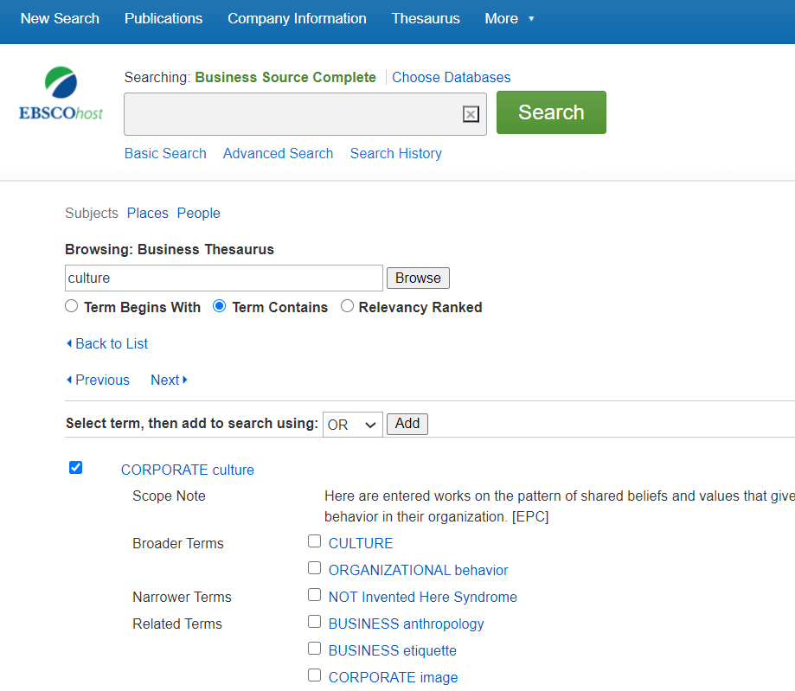
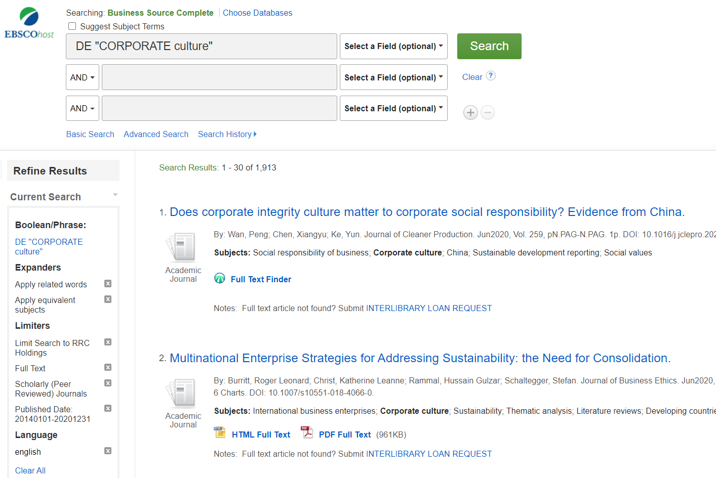
Notes:
The first example here shows what happens if we click on a subject from the Thesaurus. The Corporate Culture ‘Scope Note’ tells us what is meant by and encompassed by the term. Below this we see broader terms, narrower terms and related terms. You can click on any of these to see their scope note and what they cover, or alternately you can click on the box beside one or more of these, click the Search button and get results. Once you see the result list, you can add in all the limiters you feel are helpful.
The second example here shows what happens when we tick a subject box and then the Search button… We see the results come up. You can see the limiters that we added in after, to make the search more specific. You could even add additional search words to the search field below where we see Corporate Culture, such as etiquette or “social media”.

Slide 28
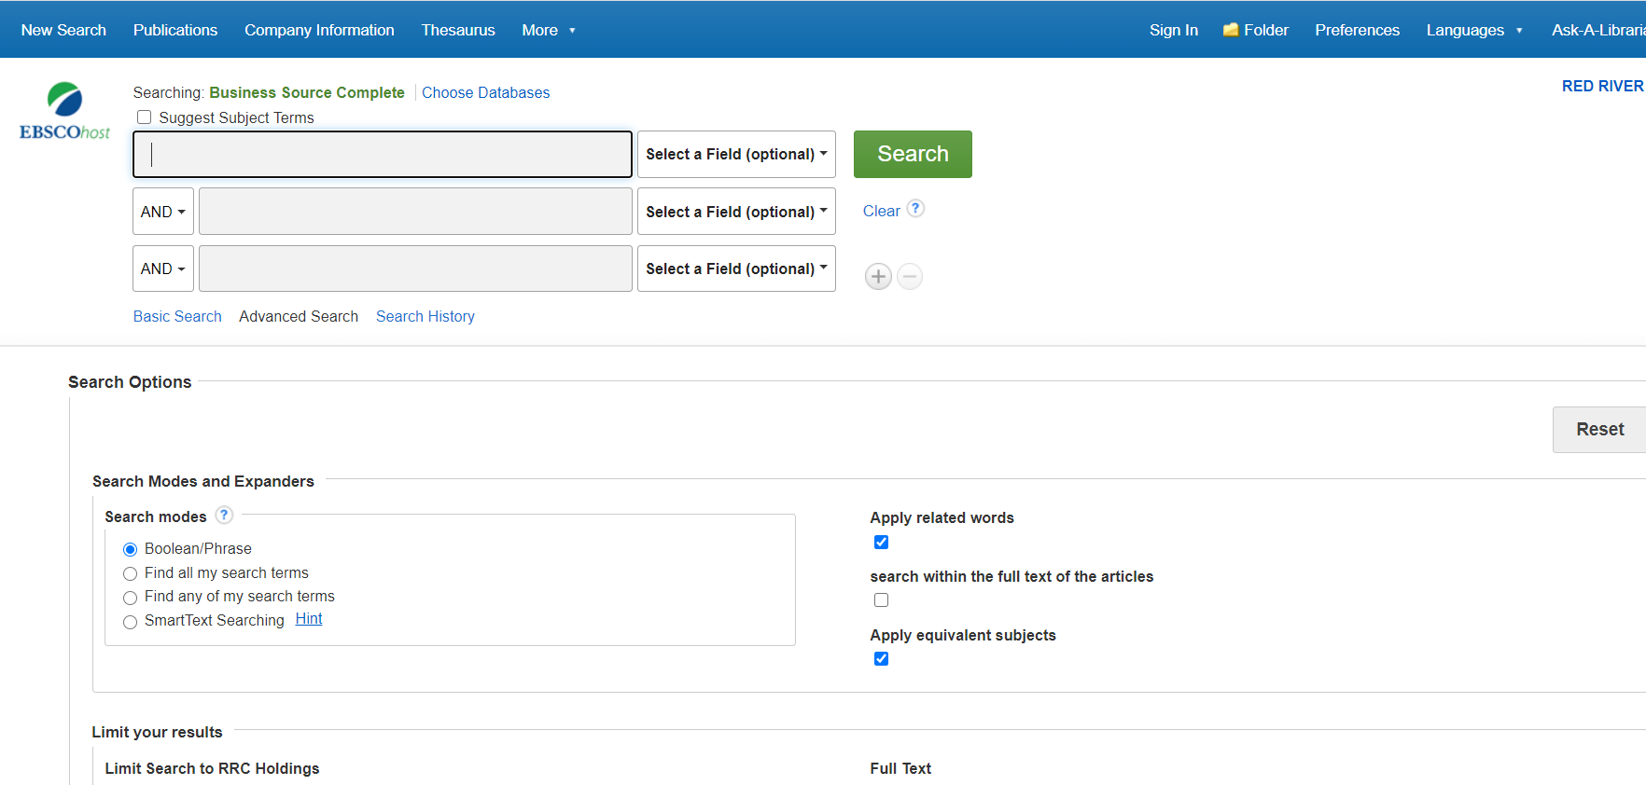
Notes:
Well, that was a pretty detailed overview of the Business Source Complete database. Try some searches on your own and see what results you can find. Remember, you can always ask us for help.

Slide 29
Further questions?
Lynn Gibson lgibson@rrc.ca
Ask Us (Chat @ library.rrc.ca)
Go to the website for more Lunch & Learn sessions, including…
OneSearch
Research Skills
UpToDate
Peer Reviewed Journals
Nursing Reference Center
Crediting Ideas
RefWorks
And more…
Notes:
Questions? Don’t hesitate to contact us. You can contact Lynn Gibson at lgibson@rrc.ca; or go to the Library homepage and click the Ask Us button to open a chat with the Reference Desk (you can ask so speak to individuals here as well)
Please check out the webpage for more information about other L&L Sessions.

Slide 30
How did we do?
Thank you for attending! If you haven't done so already, please fill out our quick survey using the following link:
https://bit.ly/RRC_Evaluation
We appreciate your feedback. Have a good day!
Please send your questions, comments and feedback about the Lunch & Learn program to: rwoodby@rrc.ca.
Notes:
(refer to slide)

