Slide 1
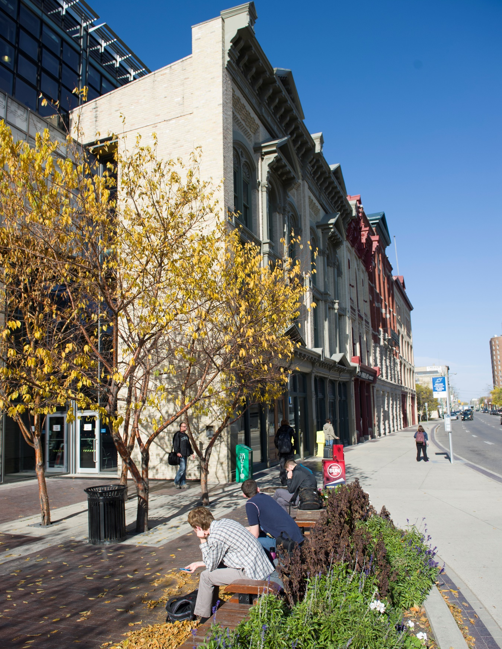
Update:
Academic and Research Plan
Christine Watson, PhD
VP Academic & Research (Interim)
April, 2016

Slide 2
Guided by RRC’s Strategic Plan, the Academic and Research Plan describes our academic priorities and informs key future decisions.
The Academic and Research Plan articulates strategies that:
contribute to student success;
strengthen collaboration and integration across and within education sectors;
ensure sustainability; and
enhance the social and economic prosperity of Manitoba.
Academic and Research Plan Executive Mandate

Slide 3
The need for a plan
The Academic and Research Plan:
Celebrates academic success
Anticipates acceleration and change
Identifies areas of opportunity and constraint
Serves as internal and external communication

Slide 4
Steering Committee
Back L-R: Lori Grenkow, Kerri Caldwell, Ray Hoemsen, Neil Cooke, Don MacDonald, Graham Thomson, Mark Aquash
Front: RaeAnn Thibeault, Jo-Anne Shay, Nancy Wheatley, Cindee Laverge, Sherrie Novak, Stephanie Fraser, Christine Crowe

Slide 5
Process/ Timeline
Spring/Summer 2015
Consultation with Steering Group
Meetings with key stakeholders
Interviews with academic leadership
Early Fall 2015
Discussion Document shared with community for feedback
Late Fall 2015
Based on feedback, developed first draft of a Plan, shared with Steering Committee
Winter 2016
Final Draft, presented to academic leadership for implementation

Slide 6
Setting the scene
Economic and labour market projections
Population/Migration/Immigration
Indigenous Achievement
Provincial Policy
Responsiveness
Learner pathways
Accountability
Excellence in teaching, research and student experience
Notes:
Population / Economy – 63% require post-secondary education
Migration – International Education / aggressive immigration policies
Indigenous Achievement –Manitoba Collaborative Indigenous Education Blueprint for Universities, Colleges and Public School Boards, September 2015
Provincial Policy – Partnerships / Collaboration

Slide 7
Red River College’s Identity
RRC is a comprehensive college, with a dominant role in the provision of professional and vocational education in Manitoba.
When RRC is weak in an area, Manitoba is weak in an area.
RRC can’t be all things to all people, but has a limited ability to specialize.

Slide 8
External perceptions
Concerns about points of contact (“Who do I speak to?”)
A desire to see more partnerships / co-ops
Support for applied research
Bachelor’s degrees were not identified as a priority
Concerns about lack of focus, increased “bureaucracy”
Worries that RRC grads lack “soft skills”

Slide 9
Internal perceptions
Strong desire to see more focus at the institution
Concerns about “silo-ism”
Strong support for International Education, but need for faculty support
Strong support for Indigenous Education, but concern about past performance
Strong student belief that their instructors “go the extra mile” for them

Slide 10
Take-aways from consultation
Strong brand to build on
A need to reach out more to employers
A need to focus on quality and agility: “fast QA”
Need to move from “good enough” to “great”

Slide 11
Three Themes
Sharpen Strategic Focus
Drive Academic Excellence
Accelerate Research and Innovation

Slide 12
1. Sharpen Strategic Focus
Shape our College through program planning
Open doors through partnerships and pathways
Create opportunities in Indigenous Education
Lead the way in International Education
Notes:
PRIORITY 1 – Shape our College through program planning
Identifying the kind of College we want to be, in terms of our role and profile: the ratios of degrees to diplomas and certificates, the program areas we will target for growth and development, and the partnerships and pathways we will develop
Use labour market intelligence and environmental scanning to ensure that our program and qualifications mix is aligned with the demands of the labour market and the economy, to anticipate future demand, and to respond to the needs of diverse populations and communities.
PRIORITY 2 – Open doors through partnerships and pathways
Develop joint programs, collaborative arrangements and flexible learning pathways in partnership with the K-12 sector and other post-secondary institutions
Leverage existing partnerships and develop new partnerships with industry to inform program development, increase opportunities for placements, and ensure that the College has access to the latest equipment and technological developments
Work in partnership with industry to anticipate future developments in technology and the organization of work, and to respond to these proactively through applied research, staff training and development, new and updated programs, and changes to teaching and curriculum.
PRIORITY 3 – Create opportunities in Indigenous Education
Follow through systematically on the ten commitments we have made as signatories to the Manitoba Collaborative Indigenous Education Blueprint for Universities, Colleges and Public School Boards
Do so within the framework of a comprehensive and holistic College strategy on Indigenous Achievement
PRIORITY 4 – Lead the way in International Education
Integrating international education into our Vision, Mission, policies, structures, decision-making processes and organizational culture
Positioning Red River College as the institution of choice for immigrants to the province
Broadening the base of our international education programs
Promoting the internationalization of teaching and learning

Slide 13
2. Drive Academic Excellence
Support teaching excellence
Pursue quality improvement
Drive program innovation
Strengthen student advising and support
Notes:
PRIORITY 1 – Support teaching excellence
Providing mentoring, training and support for our instructors
Providing opportunities for faculty to “return to industry” to ensure currency in their field
Creating new opportunities for our instructors to engage in research
Finding new ways to recognize and reward teaching excellence
PRIORITY 2 – Pursue quality improvement
College-wide implementation of quality assurance processes
Improving our responsiveness to employer feedback on the quality of our programs and graduates
Monitoring key outcome and performance indicators at the unit and program level
PRIORITY 3 – Drive program innovation
Deepen our engagement with employers, to ensure that our programs remain fresh and relevant
Explore opportunities to develop new programs and new models of delivery, including blended, inter-professional and inter-disciplinary learning
Establish streamlined processes to review, approve and fast-track the development and implementation of new, updated and blended programs
Establish streamlined processes to foster collaboration and communication across program and organizational boundaries as well as partnerships with employers and other post-secondary institutions
PRIORITY 4 – Strengthen student advising and support
Engage with the K-12 sector, with the aim of encouraging wider participation of non-traditional and first generation students
Provide accelerated access through joint programs and partnerships
Ensure learner success through advising and learner support
Strengthen student counselling and social and health supports, to meet the needs of an increasingly diverse population
Provide targeted academic support for our diverse enrolments

Slide 14
3. Accelerate Research and Innovation
Ensure sustainable growth in applied research
Serve as a community resource
Expand national and international collaboration
Notes:
PRIORITY 1 – Ensure sustainable growth in applied research
Develop a governance framework that will ensure effective integration of Applied Research into College planning, decision making, and reporting
Sharpen our focus on business development, including the development of strategic partnerships and networks in areas of research focus
Promote internal awareness of applied research and foster the development of a College-wide research community
Strengthen the nexus between teaching and research
Draw on our strengths in applied research and innovation to recruit talented researchers and engage our instructors
PRIORITY 2 – Serve as a community resource
Harness the multi-disciplinary talents, expertise and resources of the College to help address some of the key economic, environmental, and development challenges that the province faces.
PRIORITY 3 – Expand national and international collaboration
Seek new opportunities for national and international research collaboration
Create opportunities for applied research staff and student international exchanges and placements
Promote Red River College as an international destination of choice for students and faculty from other countries

Slide 15
Good Enough
Great

